Slide 1
Noun as a part of speech
Made by Kate Hamii, Ann Yvasenko,
Oleg Strel’nikov

Slide 2
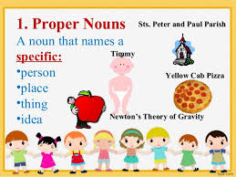
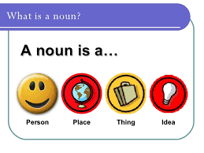
name of
a person,
a place,thing,
a quality,
a idea

Slide 3
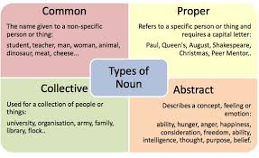
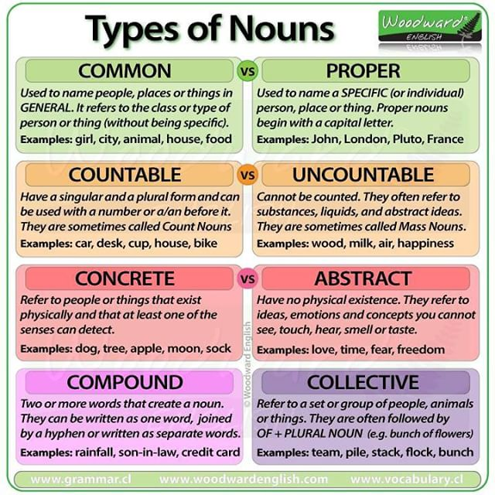
Types of Nouns in English

Slide 4
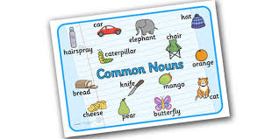
Common Noun
names a person, animal, place, thing, or idea.
Be sure to pick a top university.
Stack those boxes carefully.
Would you like a cookie with your coffee?
People are strange.
My dog won’t stop barking.

Slide 5
Examples of common nouns in English are:
time,
people,
day,
world,
number,
house,
system,
company,
end,
party,
information.

Slide 6
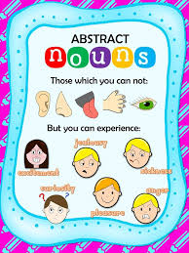
Abstract nouns
You can’t see it, smell it, taste it, hear it, or touch it.
I’d like the freedom to travel all over the world.
Joe felt a nagging sense of doom.
Love is a kind of irresistible desire; it’s hard to define.
When Sarah jumped into the lake to rescue a drowning cat, her bravery astonished onlookers.

Slide 7
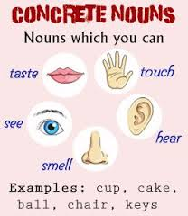
Concrete Nouns
you can touch, see, taste, feel, and hear
Please, remember to buy oranges.
Have a seat in that chair.

Slide 8
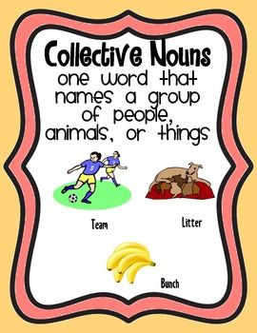
Collective Nouns
Collection or a number of people or things
Every morning, the herd follows its leader to the watering hole for a drink.
Today, Ms. Kennedy’s class takes its SOL test.
The committee agrees that people are misusing their cell phones, so its verdict is that phones must not be used during working hours.

Slide 9
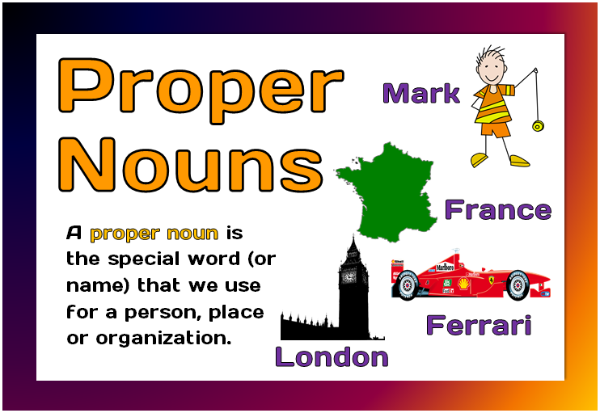
Proper nouns
Names of people, places and organisations
Mohammed Ali; Birmingham; China; Oxford University, the United Nations
festivals: Christmas; Easter; Ramadan; Thanksgiving
for someone’s title: I was talking to Doctor Wilson recently.
the names of books, films, plays and paintings I have been reading ‘The Old Man and the Sea’; Beatrix Potter wrote ‘The Tale of Peter Rabbit’;You can see the Mona Lisa in the Louvre.

Slide 10
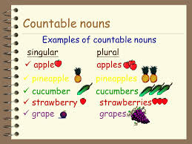
COUNTABLE AND UNCOUNTABLE NOUNS
COUNTABLE NOUNS
we can count using numbers
She has three dogs.
I own a house.
I would like two books please.
How many friends do you have?
Singular | Plural
one dog | two dogs
one horse | two horses
one man | two men
one idea | two ideas
one shop | two shops

Slide 11
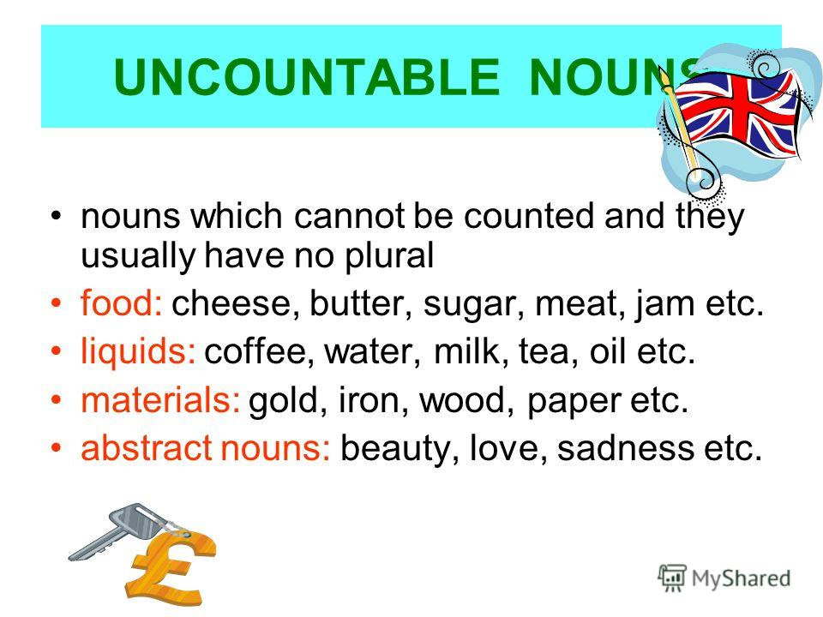
UNCOUNTABLE NOUNS
we cannot count with numbers
tea
sugar
water
air
rice
knowledge
beauty
anger
fear
love
money
research
safety
evidence

Slide 12
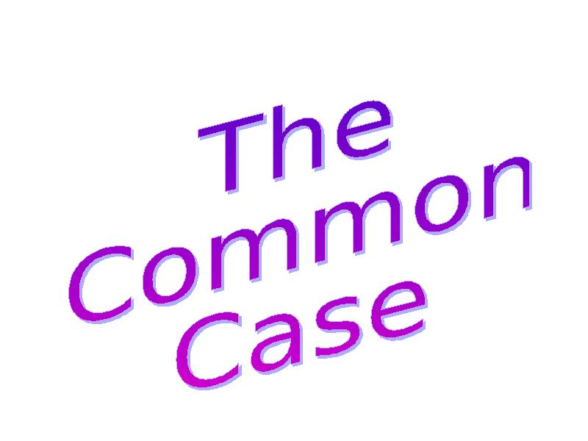
The two-case system
the common case
"The one thing that doesn't abide by majority rule is a person's conscience."
(Harper Lee, To Kill a Mockingbird, 1960)

Slide 13
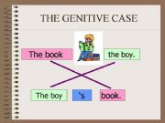
The genitive case
Singular :boy-boy’s
Student-student’s
Plural man-men’s
Woman-woman’s
Common case Possessive case
Burns Burn’s/-iz/ poems
Boz Boz’s/-iz/ sketches
Fox Fox’s/-iz/ articles

Slide 14
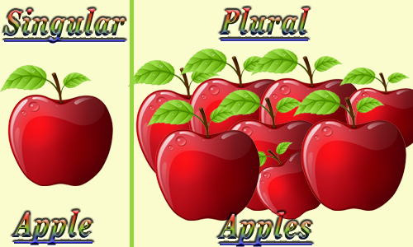
The Category Of Number
Singular Plural
Only count nouns are inflected for it.
/s/ cup cups
cat cats
/z/ bag bags
Boy boys
/iz/ bus buses
Rose roses
Study studies

Slide 15
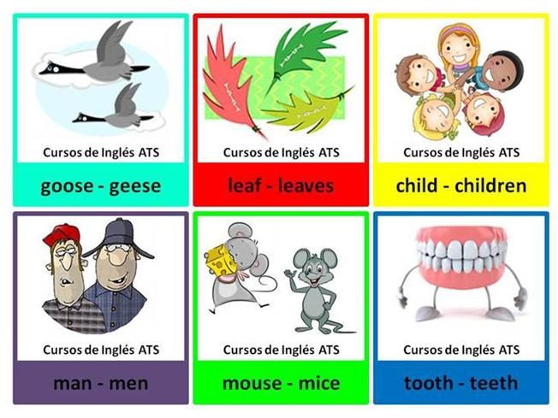
Irregular plurals
• Man-men
• Woman-woman
• Goose-geese
• Foot-feet
• Tooth-teeth
• Mouse-mice
• Louse-lice
• Child-children
• Ox-oxen
Knife-knives
Leaf-leaves
Life-lives
Loaf-loaves
Shelf-shelves
Wife-wives
Wolf-wolves

Slide 16
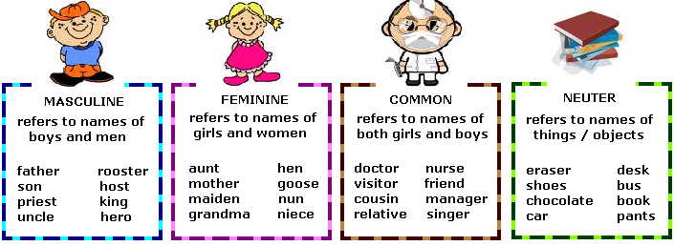
NOUN GENDER
Masculine | Feminine | Gender neutral
man | woman | person
father | mother | parent
boy | girl | child
uncle | aunt
husband | wife | spouse
actor | actress
prince | princess
waiter | waitress | server
rooster | hen | chicken
stallion | mare | horse

Slide 17
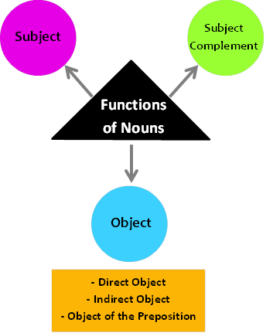
What are the Functions of a Noun?
can function as a subject, an object (object of the preposition, direct object, indirect object), and a subject complement

Slide 18
Arya Stark is really cool.
They were supposed to meet at noon.
Jeremy is a swimmer.
The beavers built a dam.
He gave Maria a love letter.

Slide 19
Thank you for your
attention!☺

