Slide 1
Conditionals

Slide 2
There are 4 kinds of conditionals:
Zero conditional
First conditional
Second conditional
Third conditional

Slide 3

Zero conditional is used to describe things that are generally true.
E.g. If the temperature goes down to zero descent, water freezes.

Slide 4

First conditional is used to describe events which are possible in the present or future.
1.If it snows 2.If I see Jane 3.If you don’t write the composition | they will go skiing I’ll invite her to my birthday party. you’ll get low grades
If + Present Simple | will + infinitive

Slide 5


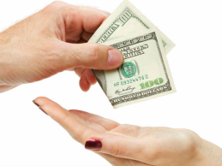


Find the equivalents in Russian
If you walk under a ladder, you will have bad luck.
If you talk of the devil |ˈdɛv(ə)l| , he will appear.
If you see a small spider, you will get a lot of money.
If you scratch your left hand, you will give money away.
If a girl catches the bride’s bouquet after a wedding, she will be the next to marry.
If a black cat crosses your path you will have bad luck.

Slide 6
Second conditional is used to describe unlikely situations in the present or future
If I knew the answer If I were you If she had money If they spoke Spanish | I would tell you I would learn German she would spend her holidays abroad they would go to Spain
If +Past Simple | would + infinitive

Slide 7

Let’s dream..
If I lived in London…
If it were Sunday ….
If I were the president…
If I could go anywhere in the world…
If I were a producer…
If my father had a lot of money…

Slide 8

Translate the poem
If all the seas were one sea,
What a great sea that would be!
If all the trees were one tree,
What a great tree that would be!
If all the axes were one axe,
What a great axe that would be!
If all the men were one man,
What a great man that would be!
If the great man took the great axe,
And cut down the great tree,
And let it fall into the great sea,
What a splish-splash that would be!

Slide 9

Compare your translation with the translation of Marshack.
Кабы реки и озера слить бы в озеро одно,
А из всех деревьев бора сделать дерево одно,
Топоры бы все расплавить
И отлить один топор,
А из всех людей на свете человека выше гор,
Кабы взяв топор могучий этот грозный великан
Этот ствол обрушил с кручи в это море океан-
То-то громкий был бы треск,
То-то шумный был бы плеск!

Slide 10
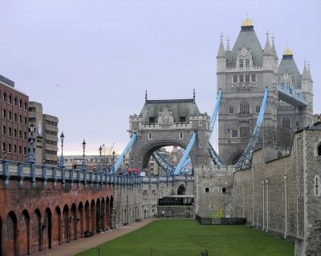
“Chain of events”
If I went to London, I’d visit the Tower.
If I visited the Tower, I would see ravens there
If I saw ravens there, I’d take their pictures.
If I took pictures, I’d show them to my friends
If I showed them to my friends …
Make your own story.

Slide 11
Put the verbs into the correct form:
1.If I (be) you I (not/marry) her.
2.If I (know) her telephone number I (phone her).
3.We (buy) a new house if it (not/be) so far away.
4.I (help) you if I (can) but I’m afraid I can’t.
5.The meat (taste) better if it (have) more spices in it.

Slide 12
5.The meat (taste) better if it (have) more spices in it.
6.If you (not/go) to bed so late every night, you (not/be) so tired all the time.
7.I (not/mind) living in Britain if the weather (be) better.

Slide 13
I wish + verb
I wish he were in Moscow
Было бы хорошо, если бы он был в Москве.
Жаль, что его нет в Москве

Slide 15

Third conditional is used to describe situations that didn’t happen in the past
If he had seen them If it hadn’t rained yesterday If I had known her address | he would have stopped them we would have gone to the country I would have written to her
If + Past Perfect | would + have+ III form

Slide 16

“Looking back.” Say that you regret something.
E.g. If I hadn’t been rude to my mother she wouldn’t have kept me from visiting my friends on Sunday.

Slide 17
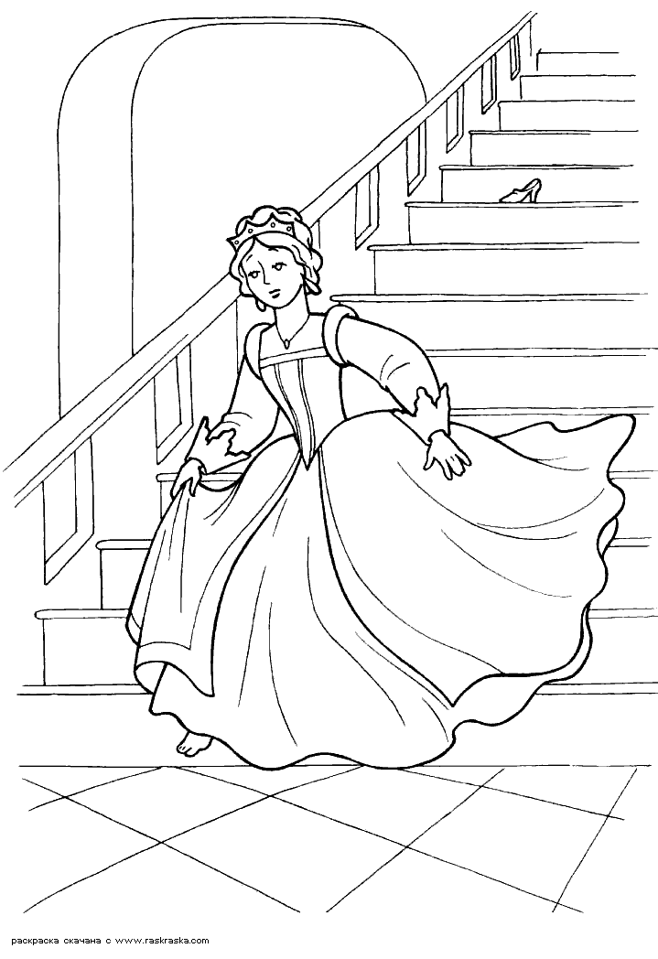
What would have happened, if…
If Cinderella hadn’t met a fairy, she wouldn’t have gone to the ball.
If she hadn’t gone to the ball, the prince wouldn’t have met her.
If the Prince hadn’t met her, he wouldn’t have fallen in love with her.
If he hadn’t fallen in love with her, he wouldn’t have tried to find her.
If he hadn’t tried to find her….

Slide 18
Источники информации
Биболетова М.З. , Бабушис Е.Е. ,Кларк О.И. “Enjoy English 9”
http://www.englishteachers.ru/
http://www.hello-online.ru/

