Slide 1

Had Better
Would Prefer to
Would Rather

Slide 2

"Had better“
General
Usage
We use “had better” plus the infinitive without “to” to give advice. Although “had” is the past form of “have”, we use “had better” to give advice about the present or future.

Slide 3
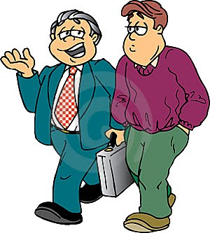
Examples:
You'd better tell her everything.
I'd better get back to work.
We'd better meet early.

Slide 4
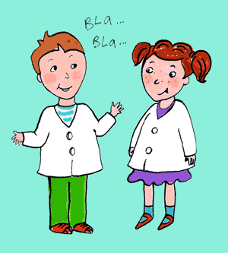
The negative form is “had better not”.
You'd better not say anything.
I'd better not come.
We'd better not miss the start of his presentation.

Slide 5
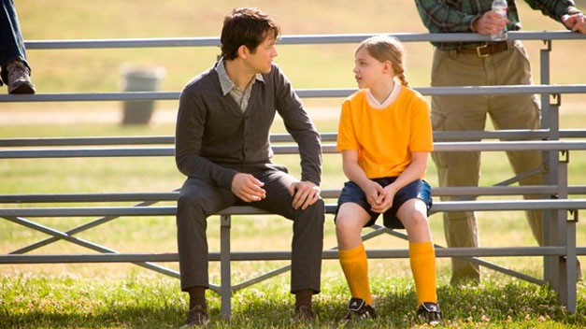
We use “had better” to give advice about specific situations, not general ones.

Slide 6
Would Prefer to
General
Diferencia importante entre "would prefer" y “would rather”: El verbo que sigue a “would rather” va en infinitivo sin “to”.
En cambio, el verbo que sigue a “would prefer” puede ir seguido de un verbo en infinitivo con “to´´ es decir Would Prefer to.

Slide 7
USING
We use "would prefer" to say what somebody wants in a particular situation (not in general), or to talk about our preferences.
Can be used for present or future preferences.
Notice that if you use a verb with would prefer, the verb is in the infinitive form.
Would prefer can be used with either a noun or a verb:
noun
They would prefer cofee
They would prefer to drink cofee
verb
We would prefer to live near the beach

Slide 8
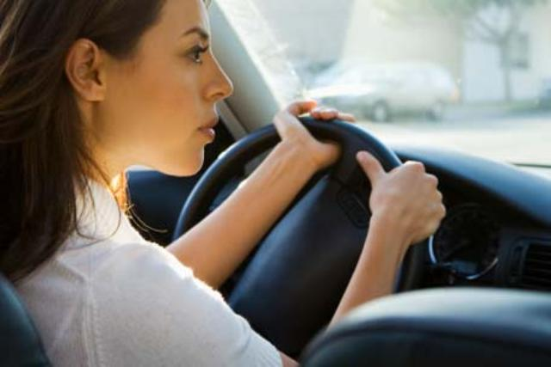
The negative of would prefer to
Use would prefer not + infinitive
Examples…
They would prefer not to drive because they don’t know this area well.

Slide 9

She would prefer not to take classes in the afternoon. The morning is more convenient for her to study.

Slide 10
Would Rather
Would rather can only be used with either a verb:
They would rather have coffee than tea.
They would rather coffee
Notice that the verb that follows would rather must be in the simple form (no" to “)

Slide 11
Would Rather
“would rather” es igual que “would prefer” y, por tanto, también significa “preferiría”.
The negative of would rather
Use would rather not + simple form
Examples…
We would rather not go out tonight because we have to get up early tomorrow.
She would rather not buy a house in this area because it‘s too far from her work.

Slide 12


