Slide 1

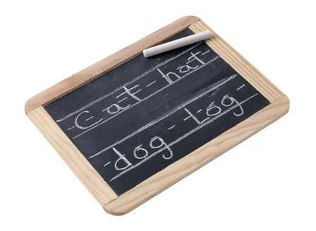
Word formation Phrasal verb GET and dependent prepositions
E
n
g
l
i
s
h
http://aida.ucoz.ru

Slide 2
Read the descriptions and fill in the correct character adjectives
Use: shy, easy-going, bossy, patient, sociable, stubborn, selfish, optimistic, caring.
1. Claire is always calm in difficult situations. She is… .
2. Sue always wants to do her own way. She is… .
3. Bob rarely gets upset and he likes meeting people. He… and… .
4. Tony doesn’t care about other people’s feelings. He is… .
5. Bill doesn’t feel comfortable with people. He is… .
6. Helen always looks on the bright side of life. She is… .
7. Fred always understands how others feel, always stays calm and doesn’t get annoyed with people easily. He worries a lot about what others think of him. He is… and…
8. John is so … . He likes telling people what to do.

Slide 3
We use the following suffixes with nouns or verbs to form adjectives in English
noun +
- ful (use - useful)
- al (magic - magical)
- ic ( optimism - optimistic)
verb +
- able (rely - reliable)
- ed (bore - bored)
- ing (bore - boring)
noun +
- ish (self - selfish)
- less (help - helpless)
- ly (friend - friendly)
- ous (fury - furious)
verb +
- ible (sense - sensible)
- ive (act - active)

Slide 4
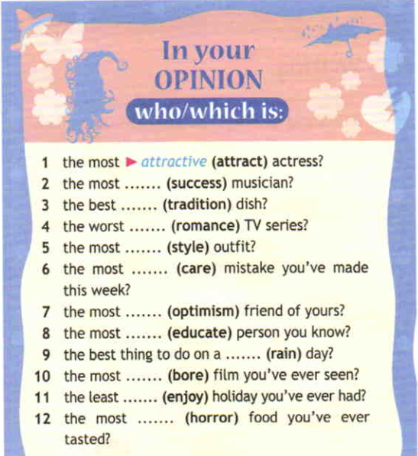
Forming adjectives . Ex 1b), p20.
successful
traditional
romantic
stylish
careless
optimistic
educated
rainy
boring
enjoyable
horrible

Slide 5
along
over with
across
GET
down
over

Slide 6
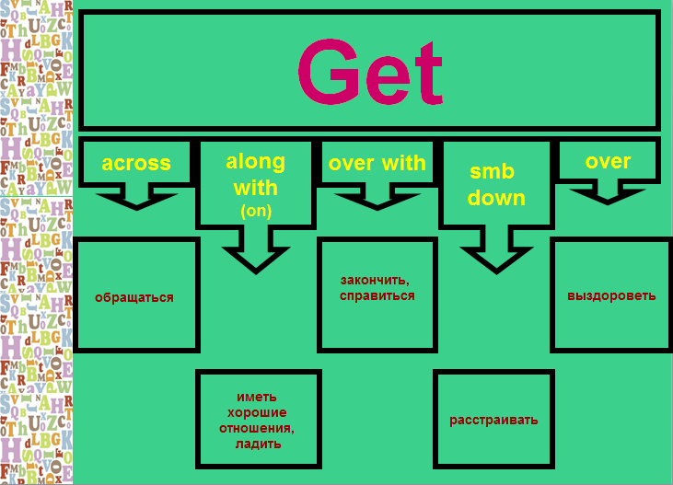

Slide 7
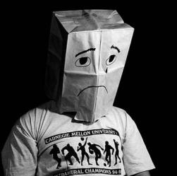
Get down
To make smb feel sad or lose hope
Doing the same thing every day can get you down

Slide 8

Get on with
To be friendly to each other
I get on well with most of my classmates

Slide 9
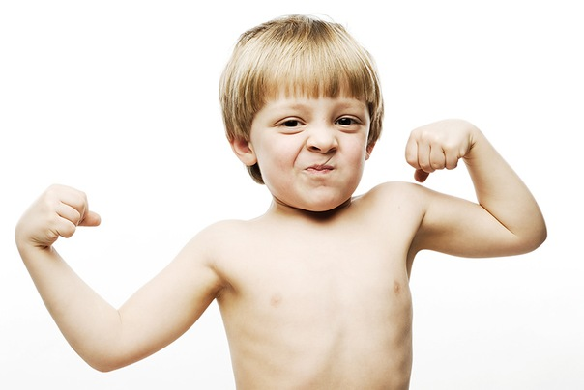
Get over
To feel good again after illness
  It can take weeks to get over an illness like that

Slide 10
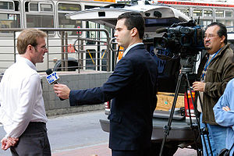
Get over with
Do and finish smth difficult or unpleasant
I wanted to get over with the interview as quickly as possible

Slide 11

Get across
To make people understand smth
What idea are you trying to get across to him?

Slide 12
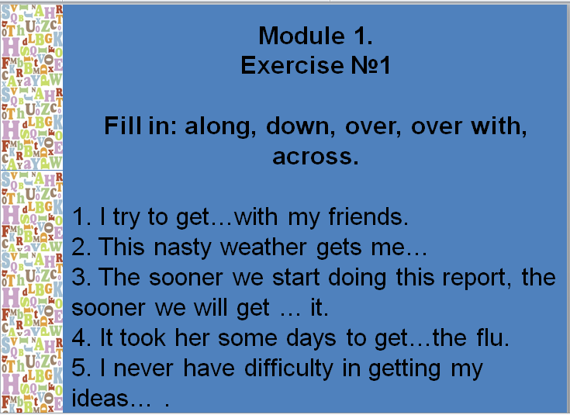

Slide 13
1) Choose the correct particle
over with
I’m afraid of injection so let’s get …… …… it as soon as possible.
How do you and John get……. ……?
I haven’t found a job yet and it is really getting me ………..
I sometimes have problems getting my meaning …………. in English.
I had such a bad cold but I get …….
on with
down
across
over

Slide 14
2) Paraphrase the sentence
Do you have good relationship with your parents?
The sooner we start writing the report, the sooner we finish it.
The rainy weather makes me sad
Alice hasn’t been recovered from the fact that she failed her exams
get on with
get over with
get down
get over

Slide 15
Dependent prepositions
be popular with | популярный
be nervous about | волнующийся о
be jealous of | ревнивый
be fond of | увлекаться
be keen on | страстно увлеченный
be good at | способный к
be proud of | гордиться чем-либо
be close to | близкий к
be patient with | терпеливый к

Slide 16
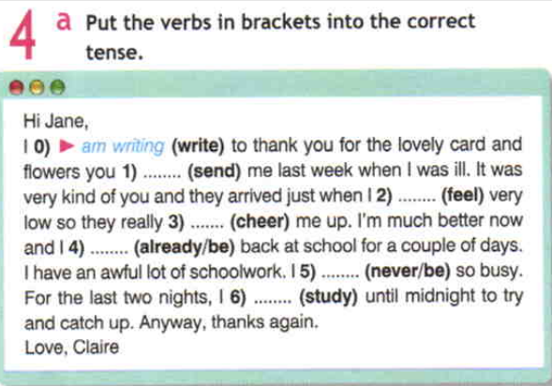
sent
was feeling
cheered
have already been
have never been
have been studying

