Slide 1

How to compare and contrast

Slide 2
Introduction
I’m going to talk about ….
My topic today is …..
There is a number of similarities and differences.
I can identify certain differences as well as similarities.
Let me start with …
I’d like to begin with …

Slide 3
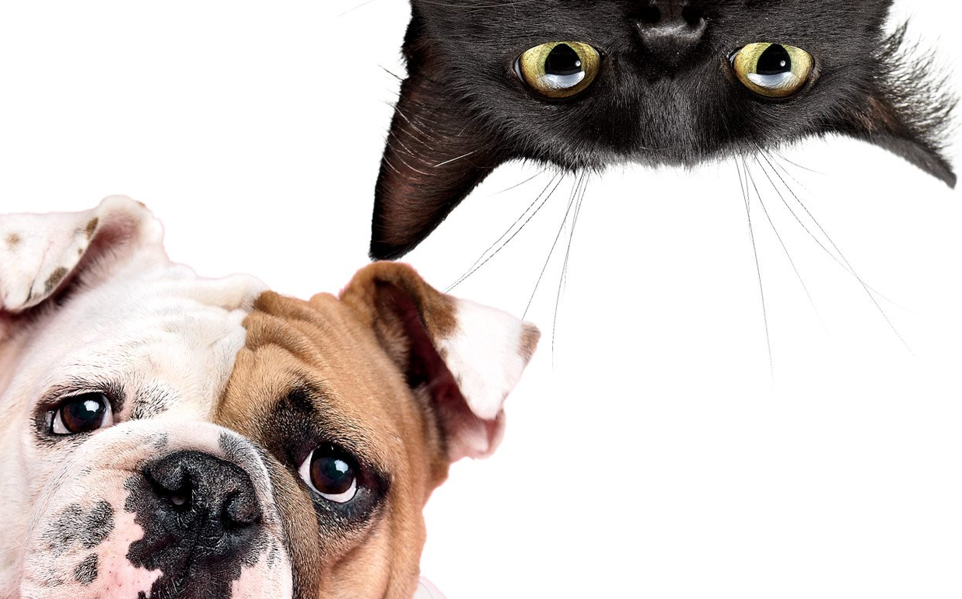
Why don’t we compare …

Slide 4
Similarities
Pattern 1
Both cats and dogs are great pets.
noun noun
Like cats , dogs are great pets.
noun noun

Slide 5
Similarities
Pattern 2
Cats love playing with children.
Similarly ,
In the same way , dogs are excellent companions
Likewise , for kids.
In comparison* ,
* Is used for both similarities and differences

Slide 6
Similarities
Pattern 3
Dogs are similar to cats …
Dogs are the same as cats …
… when it comes to healthcare.
… when we talk about cleaning after them.
… speaking about some habits.

Slide 7
Differences
Pattern 1
Dogs can live indoors and outdoors , whereas / while cats usually stay in the house.
Pattern 2
On the one hand , cats are lazy and sleep a lot.
On the other hand , they are skillful hunters.

Slide 8
Differences
Pattern 3
Though cats are they can
Although domestic , survive
Even though animals in the wild

Slide 9
Differences
Pattern 4
Despite having excellent
In spite of hunting skills // , cats are lazy
excellent hunting skills
Gerund (V+ing) // Noun

