Slide 1

Hello?
“R-i-n-g!
R-i-n-g!”
Hello. May I speak to Gary, please?
Speaking.
Hi, Gary. This is Jim.
You didn’t come to school today. What’s the matter with you?
I have a broken arm.
The doctor told me to
get an X-ray of my arm.
Oh, no. I’m sorry to hear that. Get well soon.
Thank you.
Take care. Goodbye.
Bye.
STUDENT A ~ You’re sick and couldn’t go out today.
Find out what you couldn’t do and who you couldn’t meet.
Write your friend’s name on the line.
play football with
_______________
go to John’s birthday party with ___________
go jogging with
_______________
go to piano class with ___________
go to the cinema with ___________
go to the library
with ___________
go fishing with
_______________
eat dim sum with
_______________
go to school with
_______________
go cycling with
_______________
go to the beach with ___________
go skating with
_______________
go swimming with
_______________
surf the net with
_______________
go to KFC with
_______________
go hiking with
_______________
play chess with
_______________
play tennis with
_______________

Slide 2

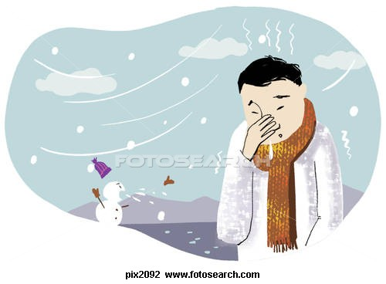
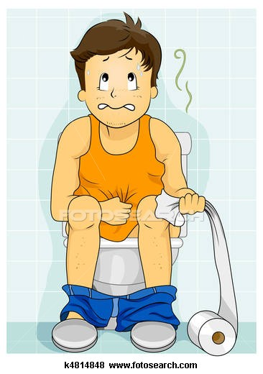

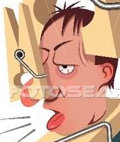
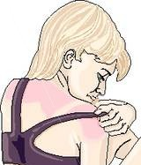
Hello?
“R-i-n-g!
R-i-n-g!”
Hello. May I speak to Gary, please?
Speaking.
Hi, Gary. This is Jim.
You didn’t come to school today. What’s the matter with you?
I have a broken arm.
The doctor told me to
get an X-ray of my arm.
Oh, no. I’m sorry to hear that. Get well soon.
Thank you.
Take care. Goodbye.
Bye.
STUDENT B ~ Your friends are sick & couldn’t meet you today.
Find out what is the matter with them.
Write your friend’s name on the line.
____________
has pink eye
____________
has a bloody nose
____________
has a cough
____________
has a runny nose
____________
has a broken arm
____________
has a stomachache
____________
has a cut
____________
has a toothache
____________
has a fever
____________
has diarrhea
____________
has a sore throat
____________
has a stuffy nose
____________
has a bruise
____________
has a cold
____________
has a headache
____________
has a sunburn
____________
has a cat allergy
____________
has a backache

Slide 3
Health – Telephone Role Play
A role play dialogue that gives students practice with health vocabulary while reviewing everyday activities like going cycling and playing tennis.
Contents -
Page one – Student A worksheet
Page two – Student B worksheet
Page three – Instructions
Pages four through nine – These are the ailment/treatment cards. Cut the paper in thirds, with the ailment and its treatment attached. For example, “a broken arm” and “get an X-ray of my arm” should be attached, then folded over to make a square card with the ailment on one side and the treatment on the other. Do this with all 18 cards. They may then be laminated or just taped together.
Pages ten through twelve – These are the activity cards. Each square needs to be cut out and laminated (if possible) to make 18 cards.
Instructions -
Divide the class in half. I designed this activity for a class of 36 students. Give the first half the Student A worksheet. Give each student a treatment/ailment card.
Give the other half the Student B worksheet. Give each student an activity card.
Review the dialogue and vocabulary. Make sure students understand how to do substitute their own names and the info on their cards into the dialogue.
Have all the “A” students line their chairs against the walls (facing the wall) or out in the hallway if there isn’t enough room in the classroom. They should sit and face the wall. All “B” students should line their chairs up behind the “A” students (one “B” behind each “A”) and sit down facing “A’s” back. If there really isn’t room to move the chairs, they can just stand instead.
“B” calls “A” by tapping “A” on the shoulder and making a telephone ringing sound. “A” pretends to pick up the phone and begins the conversation. Students can not show each other their cards or look at each other. When the conversation is finished, students should fill in the name of the other person in the correct blank on their worksheet.
When the phone conversation is over, “B” stands up and looks around the room for an empty chair behind another “A”. “B” sits down and begins another phone chat. If there aren’t any available chairs at the moment, they should stand in the middle of the room or against the opposite wall and wait until a seat becomes available. Continue until students have filled in all the blanks on their worksheet or until time runs out.

Slide 4
a broken arm
a cough
a headache
get an X-ray of my arm
take some cough syrup
rest in bed

Slide 5
a cold
a fever
a stomachache
eat more fruit
drink more water
take some medicine

Slide 6
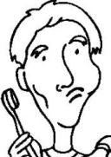
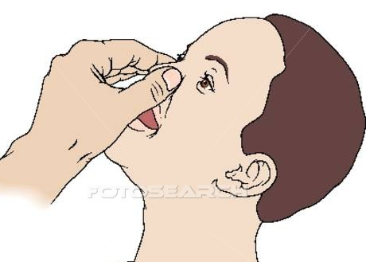

a sore throat
a toothache
a bloody nose
gargle with salt water
chew on some ginger
pinch my nose
for 20 minutes

Slide 7
a runny nose
a stuffy nose
a sunburn
blow my nose
with soft tissues
get more sleep and
use more pillows
take a cool bath

Slide 8
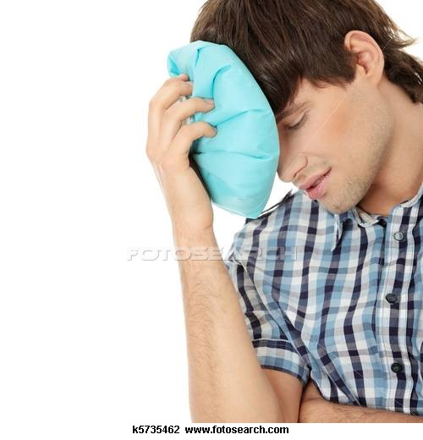
a cut
diarrhea
a bruise
put some cream on it
and use a bandage
take some medicine
and eat more congee
put some ice on it

Slide 9
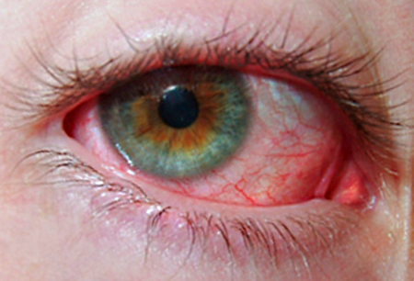
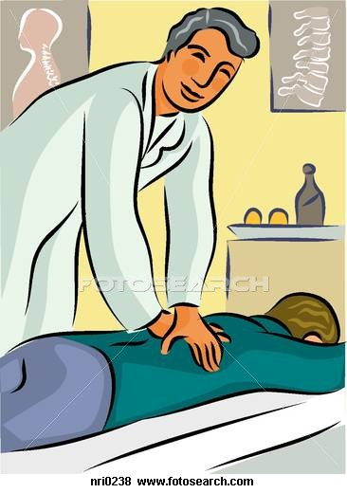
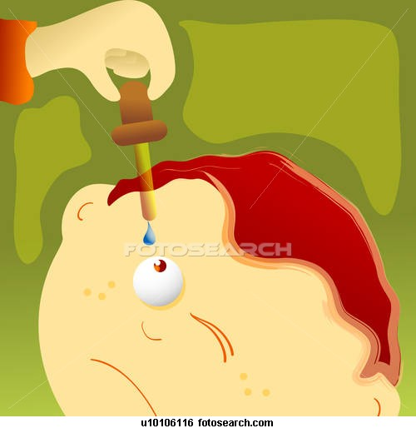
a backache
a cat allergy
pink eye
get a massage
stay away from cats
use some eye drops

Slide 10
play football
play tennis
come to school
come to John’s
birthday party
go for dim sum
go skating

Slide 11
go swimming
go hiking
go jogging
go cycling
come to the library
surf the net

Slide 12
come to the beach
come to piano class
come to KFC
come to the cinema
play chess
go fishing

