Slide 1

LEARNING ENGLISH: SOME USEFUL METHODS AND TIPS

Slide 2
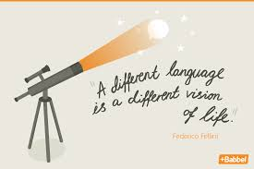


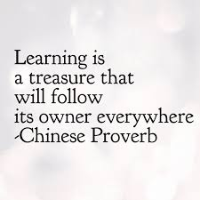
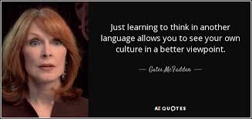

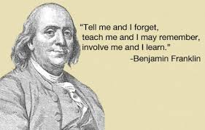
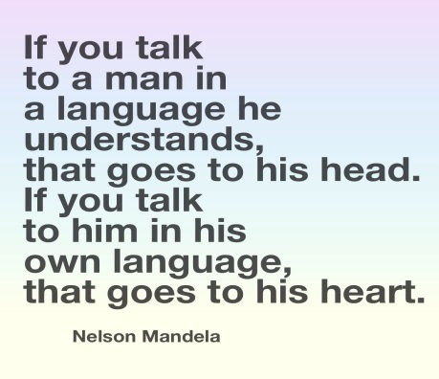
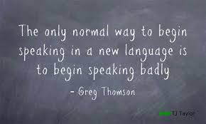

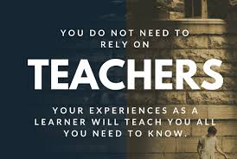

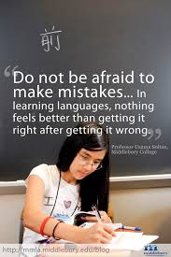
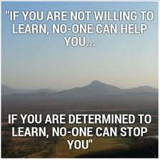

LEARNING LANGUAGES

Slide 3

1. Modern tendencies: communication skills and language aspects
2. Key elements for choosing an appropriate method or technics
3. Different Methods and Technics nowadays

Slide 4

Modern tendencies: communication skills and language aspects
Communication skills
2) Important language aspects

Slide 5
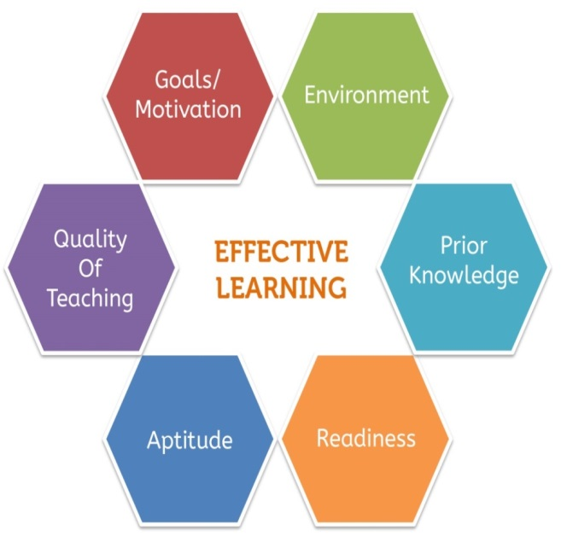
Key elements for choosing an appropriate method or technics
Goal
Age
Level (A1-C2)
Time for learning, deadline
Motivation
Personal characteristics
….
https://www.engvid.com/conversation-skills-whats-your-communication-style/

Slide 6

Methods and Technics
Pimsleur
The gist of the approach is this:
1) You hear the words and phrases in the target language.
2) You hear them in your mother tongue.
3) You translate the word from your mother tongue to the target language.
The course is based on research by Paul Pimsleur, a linguist who sought to discover the fastest way to learn a language. The length of each course varies from around 15 to 45 hours, depending on the language. The courses are broken up into half-hour sessions. Nearly everything is audio-based, and even the provided reading material is meant to be read along with the audio lessons.

Slide 7

Methods and Technics
2. Dmitry Petrov
The gist of the approach is this:
1) You learn key phrases.
2) You don’t spend much time.
3) You speak a simple language only for communication.

Slide 8

Methods and Technics
3. A. J. Hoge Effortless English
You Learn Grammar Without “Rules”: Use English grammar correctly by learning grammar in a natural way.
The Deep Learning method that helps you use English faster. Remember English words and grammar– and use them in real conversations. Feel strong about your speaking ability.
The way you learn English in a relaxing way by listening to real English articles about interesting topics. Imagine thinking, smiling, and laughing while learning.
The way you avoid stress and slow speech. The fun and crazy mini-stories train you to speak and respond faster.
How the best English speakers learn, how they study, and how you can use the methods they use. To be successful, copy the most successful people.
Lessons that help you learn English without boredom- no more textbooks, no more tests, no more “exercises”.

Slide 9
Methods and Technics: useful resources
https://www.engvid.com/
http://learnenglish.britishcouncil.org/en
http://www.elllo.org/
http://www.bbc.com/russian/learning_english
http://fenglish.ru/english-in-a-minute-anglijskij-za-minutu/
http://fenglish.ru/

Slide 10

Thank you for your attention and participation
Tatiana R.Blokhina (Kaneeva)
Email: tk-10421@mail.ru
Skype: tanusha.kaneeva

