Slide 1
Ba’zi irratsional funksiyalarni interallash

Slide 2
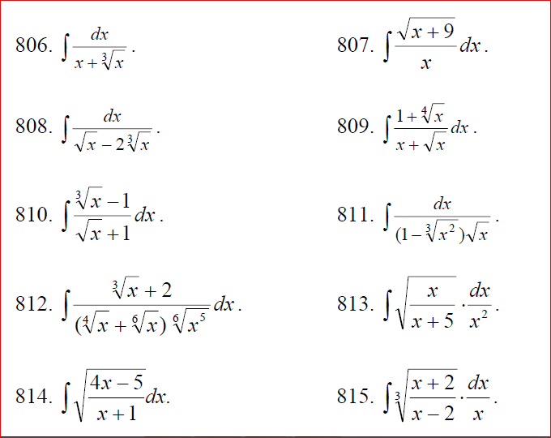

Slide 4
