Slide 1
MAVZU: BA`ZI IRRATSIONAL FUNKSIYALARNI INTEGRALLASH

Slide 2
Mavzuning maqsadi:
a) ta’limiy: Talabalarga ba`zi irratsional funksiyalarni integrallash haqida ma’lumot berish, hamda ularni masalalar yechishda qo’llashga o’rgatish.
b) tarbiyaviy: Talabalarda mavzu orqali matematika faniga qiziqishlarinini yanada oshirish. Matematika fanini kundalik turmush bilan bog’lab talabalarga aqliy tarbiya berish, chizmalarni chizishda estetik tarbiya berish.
v) rivojlantiruvchi: Miyaga hujum orqali xotirani mustahkamlash

Slide 3
REJA:
SODDA IRRATSIONAL FUNKSIYALARNI INTEGRALLASH
TRIGONOMETRIK ALMASHTIRISHLAR YORDAMIDA INTEGRALNI HISOBLASH
INTEGRALNI EYLER ALMASHTIRISHLARI YORDAMIDA HISOBLASH
BINOMIAL DIFFERENSIALNI INTEGRALLASH
SAVOL VA TOPSHIRIQLAR
FOYDALANILGAN ADABIYOTLAR

Slide 4
funksiyalarni integrallash usullari
.
.
.
.

Slide 5
O`TILGAN MAVZU YUZASIDAN SAVOLLAR
Ratsional funksiya deb nimaga aytiladi?
Sodda ratsional kasrlar deb nomlanadigan kasrlar asosan necha xil ko`rinishda bo`ladi?
Ratsional funksiyalarni integrallash vaularni xossalari?
Ratsional funksiyalarni integrallashda noma`lum koeffitsiyentlar va xususiy qiymatlar metodining ahamiyati.

Slide 6
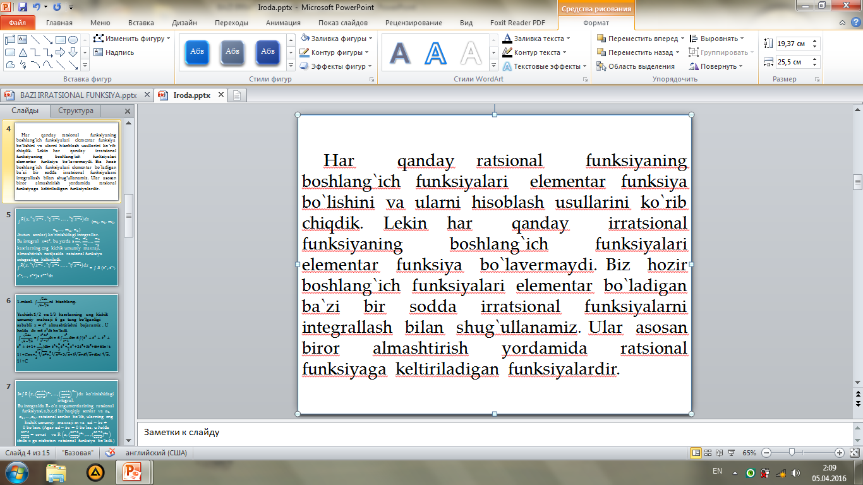

Slide 7

$\int{\begin{aligned}R\left(x,\sqrt[n_{1}]{x_{}^{m_{1}}} ,\sqrt[n_{2}]{x_{}^{m_{2}}} ,…,\sqrt[n_{k}]{x_{}^{m_{k}}}\right)dx \\ \end{aligned}}$ ($m_{1}$, $n_{1}$, $m_{2}$, $n_{2}$,..., $m_{k}$, $n_{k}$)
-butun sonlar) ko`rinishidagi integrallar.
Bu integral x=$t^{s}$, bu yerda s $\frac{m_{1}}{n_{1}}$, $\frac{m_{2}}{n_{2}}$,..., $\frac{m_{k}}{n_{k}}$ kasrlarning eng kichik umumiy maxraji, almashtirish natijasida ratsional funksiya integraliga keltiriladi.
$\int{\begin{aligned}R\left(x,\sqrt[n_{1}]{x_{}^{m_{1}}} ,\sqrt[n_{2}]{x_{}^{m_{2}}} ,…,\sqrt[n_{k}]{x_{}^{m_{k}}}\right)dx \\ \end{aligned}}$= $\int{R (t^{s}},$ $t^{r_{1}}$, $t^{r_{2}}$,..., $t^{r_{k}})$s $t^{s−1}$dt

Slide 8
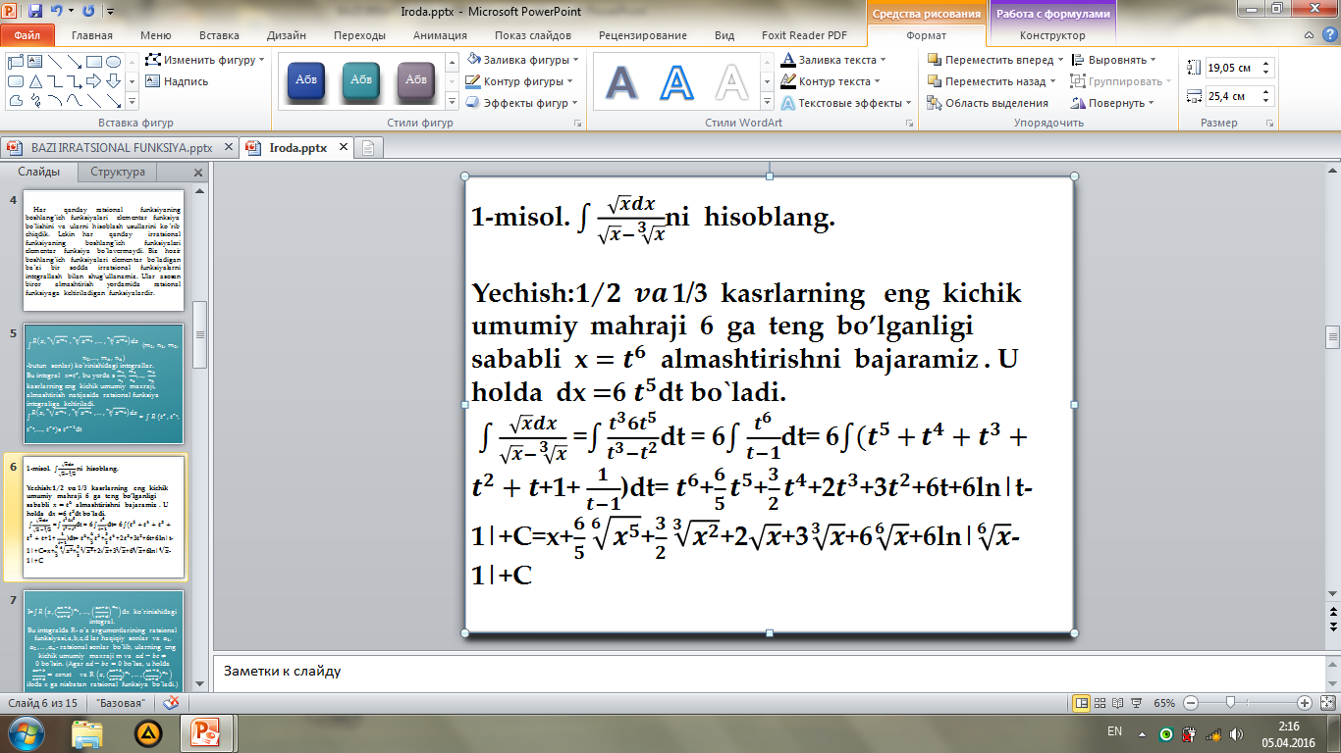

Slide 9
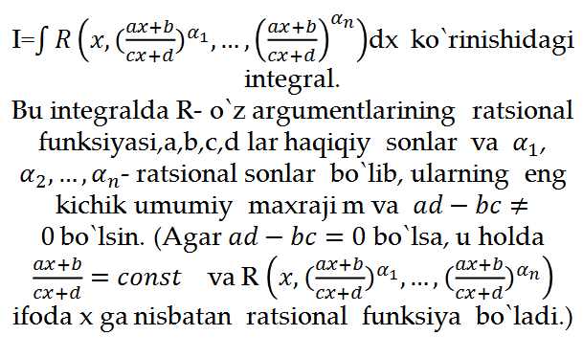

Slide 10

Quyidagi $t=\sqrt[m]{\frac{ax+b}{Cx+d}}$ yoki $t^{m}=\frac{ax+b}{cx+d}$ almashtirishni kiritamiz. U holda $x=\frac{t^{m}d−b}{a−ct^{m}}$va $dx=\frac{m(ad−bc)t^{m−1}dt}{{\left(a−ct^{m}\right)}^{2}}$ bo`ladi. Natijada, berilgan integral $t$ ga nisbatan ratsional funksiyani integrallashga keltiriladi, ya`ni
$I=\int{R(\frac{{dt}^{m}−b}{a−ct^{m}}, t^{α_{1}m},,t^{α_{n}m})\frac{m(ad−bc)t^{m−1}}{{\left(a−ct^{m}\right)}^{2}}}dt$
Bundan avval R ning argumentlari irratsional ifodalardan tashkil bo`lsa, endi argumentlar ratsional va butun ratsional funksiyalarga keltirildi.
Qisqacha qilib yozsak, $I=\int{R_{1}\left(t\right)dt,}$ bunda $R_{1}(t)$- ratsional funksiya. Avval olingan natijalarga ko`ra bunday integral elementar funfsiyalar orqali ifodalanadi

Slide 11

2-misol. $I=\int{\frac{dx}{\sqrt{x+1}−\sqrt[3]{x+1}}}$ integralni hisoblang.
Yechish. Integral ostidagi funksiya bo`lib, bu yerda $a_{1}$= $\frac{1}{2}, α_{2}=\frac{1}{3}.$Bu kasrlarning eng kichik umumiy maxraji m=6. U holda $t^{6}=x+1, x=t^{6}−1, dx=6t^{5}dt, \sqrt{x+1}=t^{3}, \sqrt[3]{x+1}=t^{2}$ almashtirishlarni bajarib, quyidagi $I=\int{\frac{6t^{5}dt}{t^{3}−t^{2}}=6\int{\frac{t^{3}dt}{t^{}−1}} }$integralga kelamiz. Natijada
$I=6\int{\left(t^{2}+t+1+\frac{1}{t−1}\right)}dt=2t^{3}+3t^{2}+6t+\ln\left|t−1\right|+C=2\sqrt{x+1}+3\sqrt[3]{x+1}+6\sqrt[6]{x+1}+6ln\left|\sqrt[6]{x+1}−1\right|+C$ bo`ladi

Slide 12

$I_{1}=\int{\frac{dx}{\sqrt{ax^{2}+bx+c}}}{, I_{2}=\int{\frac{\left(Ax+B\right)dx}{\sqrt{ax^{2}+bx+c}}},I}_{3}$= $\int{\frac{dx}{x\sqrt{ax^{2}+bx+c}}}$, ko`rinishdagi integrallar . $I_{1 }$integralni hisoblash uchun ildiz ostidagi ifodadan to`la kivadrat ajratladi: $ax^{2}+bx+c=a\left({\left(x+\frac{b}{2a}\right)}^{2}+\left(\frac{c}{a}−\frac{b^{2}}{4a^{2}}\right)\right)=a({\left(x+\frac{b}{2a}\right)}^{2} ±k^{2})$. Keyin esa x+$\frac{b}{2a}=u,$ dx= du almashtirish bajariladi. Natijada intgral jadvaldagi ushbu $\int{\frac{du}{\sqrt{u^{2}±k^{2}}}}$ ko`rinishdagi integralga keltiriladi. ${ I}_{2}$ integral suratida ildiz ostidagi ifodaning diffrensiali ajratib olinadi va bu integral yig`indisi ko`rinishida ifodalanadi

Slide 13

$$I_{2}=\int{\frac{\left(Ax+B\right)dx}{\sqrt{ax^{2}+bx+c}}=\int{\frac{\frac{A}{2a}\left(2a+b\right)+(B−\frac{Ab}{2a})}{\sqrt{ax^{2}+bx+c}}dx=}}$$
$$=\frac{A}{2a}\int{\frac{d(ax^{2}+bx+c)}{\sqrt{ax^{2}+bx+c}}}+\left(B−\frac{AB}{2a}\right)I_{1}=$$
=$\frac{A}{2a}\int{{\left(ax^{2}+bx+c\right)}^{−\frac{1}{2}}}d\left(ax^{2}+bx+c\right)+\left(B−\frac{Ab}{2a}\right)I_{1}=$
= $\frac{A}{2a}\sqrt{ax^{2}+bx+c}$. Bu yerda: $I_{1}$ yuqorida hisoblangan integral.
$I_{3}$ integralni hisoblash $x=\frac{1}{u}, dx=−\frac{1}{u^{2}}du$ almashtirish yordamida $I_{1}$ ga keltiriladi.
3-misol. $\int{\frac{3x−1}{\sqrt{x^{2}+2x+2}}dx }$ ni hisoblang.
Yechish. Berilgan integral $I_{2}$ ko`rinishidagi integral.
$\int{\frac{3x−1}{\sqrt{{\int{\frac{d(x+1)}{\sqrt{{(x+1)}^{2}+1}}=3\sqrt{x^{2}+2x+2}}−4ln\left|x+1+\sqrt{x^{2}+2x+2}\right|+C x}^{2}+2x+2}}dx }$=$\int{\frac{\frac{3}{2}\left(2x+2\right)−4}{\sqrt{x^{2}+2x+2}}dx=\frac{3}{2}\int{{{(x}^{2}+2x+2)}^{−\frac{1}{2}}}d}\left(x^{2}+2x+2\right)$-4

Slide 14


$$.$$
4-misol. $\int{\frac{dx}{x\sqrt{x^{2}+2x−1}}}$ ni hisoblang.
Yechish. Ushbu integral $I_{3}$ ko`rinishdagi integral.
$$\int{\frac{dx}{x\sqrt{x^{2}+2x−1}}=\left|\begin{aligned}x=\frac{1}{u} \\ dx=−\frac{1}{u^{2}}du\end{aligned}\right|=−\int{\frac{udu}{u^{2}\sqrt{\frac{1}{u^{2}}+\frac{2}{u}−1}}=}}$$
$$=−\int{\frac{du}{\sqrt{1+2u−u^{2}}}=\int{\frac{d\left(u−1\right)}{\sqrt{2−{\left(u−1\right)}^{2}}}=−arcsin\frac{\frac{1}{x}−1}{\sqrt{2}}+C}}=$$
$$=arccos\frac{1−x}{\sqrt{2}x}+C$$

Slide 15


Trigonometrik almashtirishlar yordamida $\int{R(x,\sqrt{ax^{2}+bx+c)}dx}$integralni hisoblash.
$\int{R(x,\sqrt{ax^{2}+bx+c)}dx}$ integrallarning xususiy hollarini hisoblashni yuqorida qarab o`tdik. Hisoblashning bir nechta usullari mavjud bo`lib, bunda biz avval trigonometrik almashtirishlariga asoslangan hisoblash usulini ko`rib o`tamiz.
$ax^{2}+bx+c$ kvadrat uchhadni to`la kvadratini ajratish va o`zgaruvchini almashtirish natijasida $u^{2}±k^{2}$ ko`rinishga keltirish mumkin. Shunday qilib, quyidagicha uch turdagi integrallarni qarash yetarli $I_{1}=\int{R(u,\sqrt{k^{2}−u^{2}}}du,$
$I_{2}=\int{R(u,\sqrt{k^{2}+u^{2}}}du,$ $I_{3}=\int{R(u,\sqrt{u^{2}−k^{2}}}du$
$$.$$

Slide 16

$I_{1}$ integral $u=ksint (u=ksint)$ almashritish natijasida sint va cost ga nisbatan ratsional funksiya integraliga keltiriladi. Haqiqatan ham, u=ksint, k>0 almashtirishdan foydalansak, du=kcostdt, $\sqrt{k^{2}−u^{2}}=kcost,$
$$\int{R(u,\sqrt{k^{2}−u^{2})}du=\int{R\left(ksint, kcost\right)kcostdt} bo`ladi.}$$
$I_{2}$ integrl esa u=ktgt yoki u=kctgt almashtirish yordamida sint va cost ga nisbatan ratsional funksiya integraliga keltiriladi.
Haqiqatan ham, u=ktgt, k>0 almashtirishni bajaramiz. U holda du=$\frac{k}{\cos^{2}t}dt, \sqrt{k{}^{2}+u^{2}}=\frac{k}{cost}$ va $\int{R(u,\sqrt{k^{2}−u^{2})}du=\int{R\left(k\frac{sint}{cost},\frac{k}{cost}\right)∙\frac{k}{\cos^{2}t}}}dt$ bo`ladi.

Slide 17

$I_{3}$ integral $u=k sect=\frac{k}{cost}$ yoki $u=\frac{k}{sint}$ almashtirish yordamida $sint$va $cost$ ga nisbatan ratsional funksiya integraliga keltiriladi. Haqiqatan ham, $u=\frac{k}{cost}$ almashtirishni bajaraylik.
U holda, $du=\frac{ksint}{\cos^{2}t}dt, \sqrt{u^{2}−k^{2}}=k\frac{sint}{cost}$ va
$\int{R(u,\sqrt{k^{2}−u^{2})}du=\int{R\left(k\frac{sint}{cost},\frac{k}{cost}\right)∙\frac{k}{\cos^{2}t}}}dt$ bo`ladi. $sint va cost$ ga nisbatan ratsional funksiya integrallari avvalgi paragrafda aytilgan metodlar yordamida hisoblanadi.
5-misol. $\int{\sqrt{a^{2}−x^{2}}}dx$ ni hisoblang.
Yechish. $\int{\sqrt{a^{2}−x^{2}}}dx=\left|\begin{aligned}x=a sint \\ dx=a costdt\end{aligned}\right|=a^{2}\int{\cos^{2}tdt=}$

Slide 18

$$=\frac{a^{2}}{2}\int{\left(1+cos2t\right)dt=\frac{a^{2}}{2}}t+\frac{a^{2}}{4}sin2t+C=\frac{a^{2}}{2}t+\frac{a^{2}}{2}sintcost+C=\left|\begin{aligned}t=arcsin\frac{x}{a} \\ sint=\frac{x}{a} \\ cost=\frac{\sqrt{a^{2}−x^{2}}}{a}\end{aligned}\right|=\frac{a^{2}}{2}arcsin\frac{x}{a}+\frac{x}{2}\sqrt{a^{2}−x^{2}}+C$$
6-misol. $\int{\sqrt{a^{2}+x^{2}}dx}$ ni hisoblang.
Yechish. $\int{\sqrt{a^{2}+x^{2}}}dx=\left|\begin{aligned}x=a tgt \\ dx=\frac{a}{\cos^{2}t}\end{aligned}dt\right|=\int{\sqrt{a^{2}(1+{tg}^{2}t)}∙\frac{a}{\cos^{2}t}}dt={=a}^{2}\int{\frac{dt}{\cos^{3}t}}$ bo`ladi. $\int{\frac{dt}{\cos^{3}t}}$ integralni hisoblashni o`quvchilarga havola qilamiz.

Slide 19
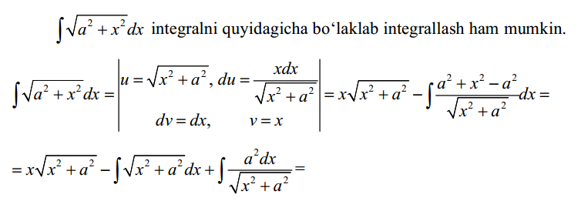
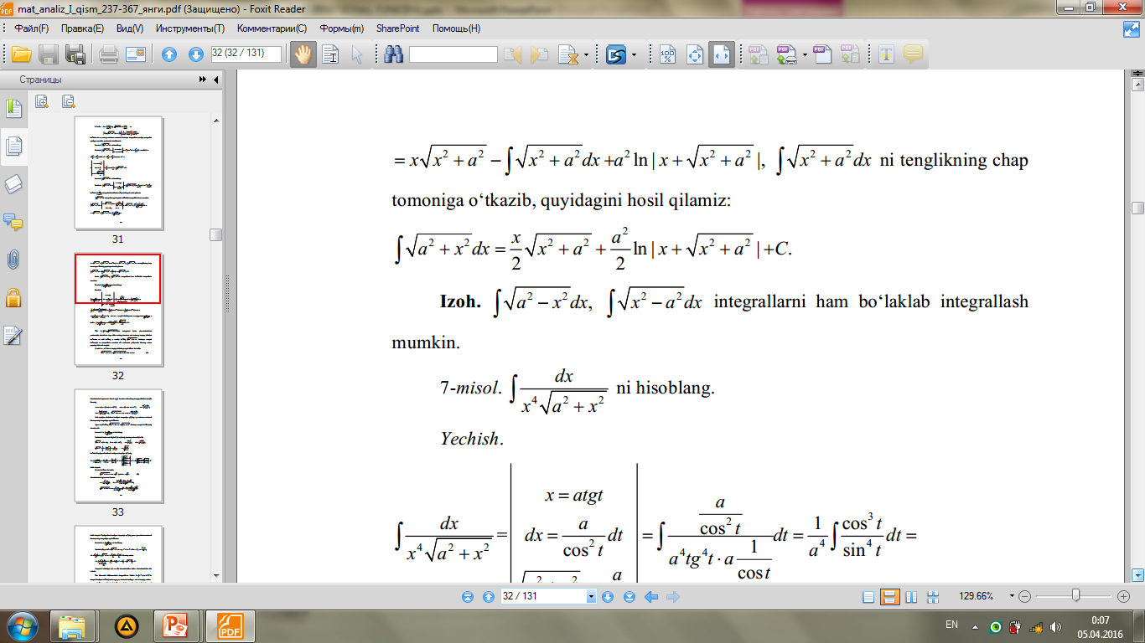

Slide 20
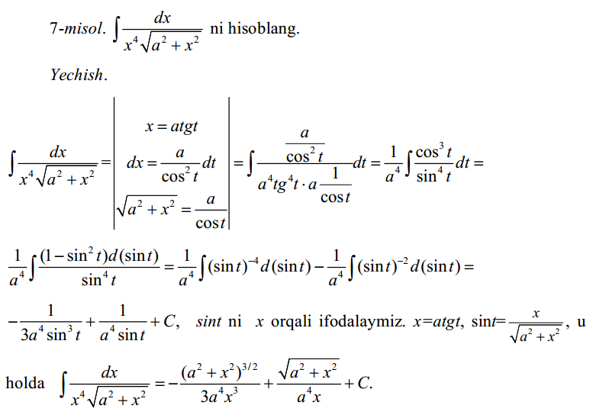

Slide 21
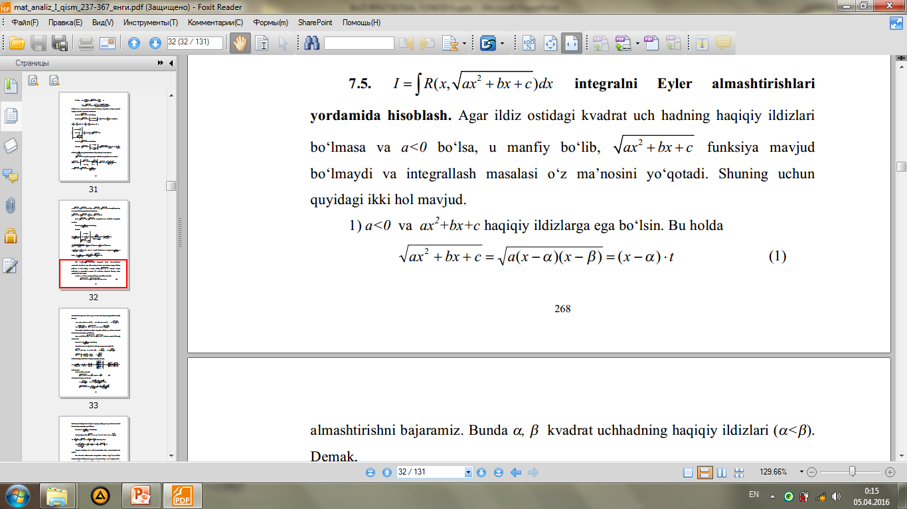

Slide 22
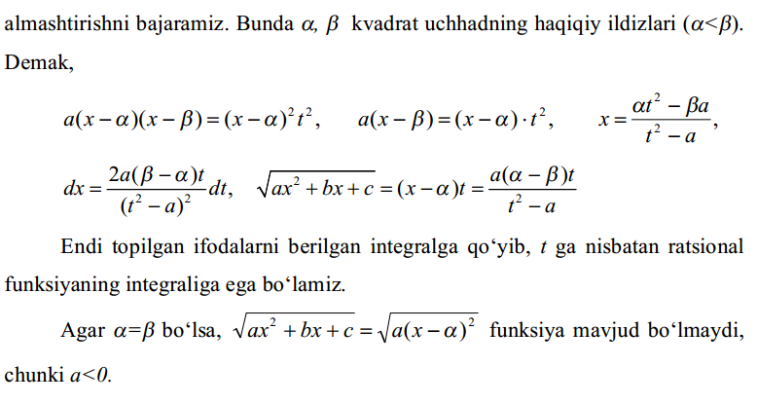

Slide 23
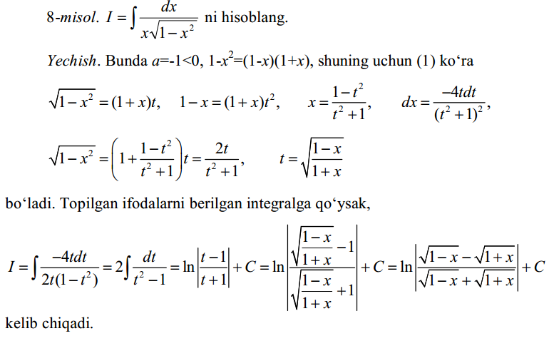

Slide 24
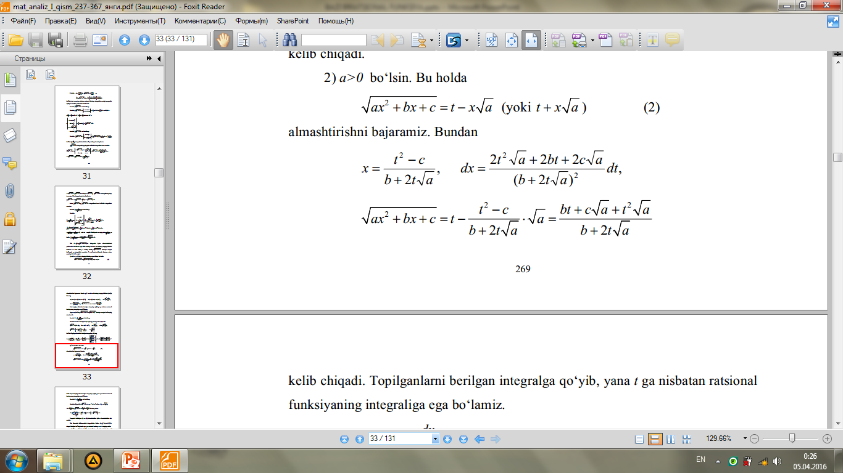

Slide 25
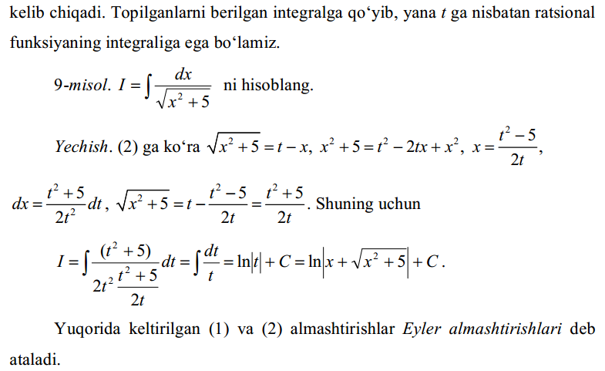

Slide 26
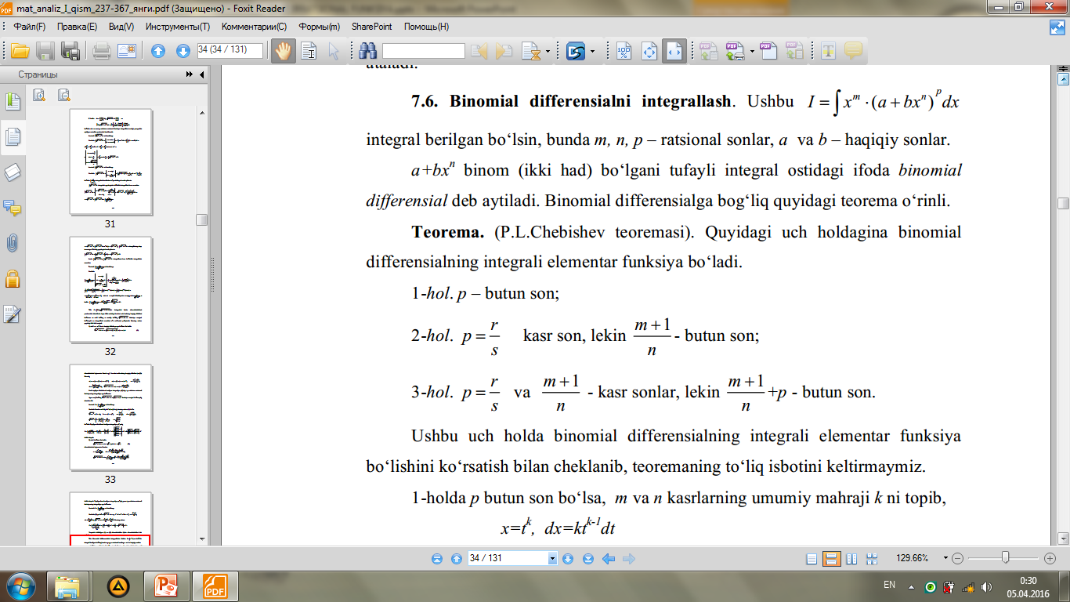

Slide 27
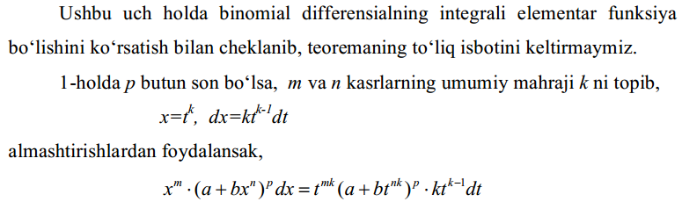
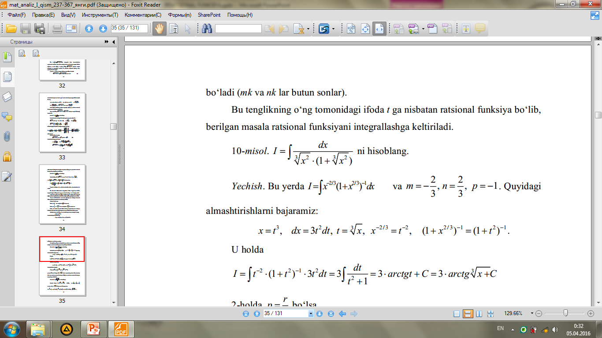

Slide 28
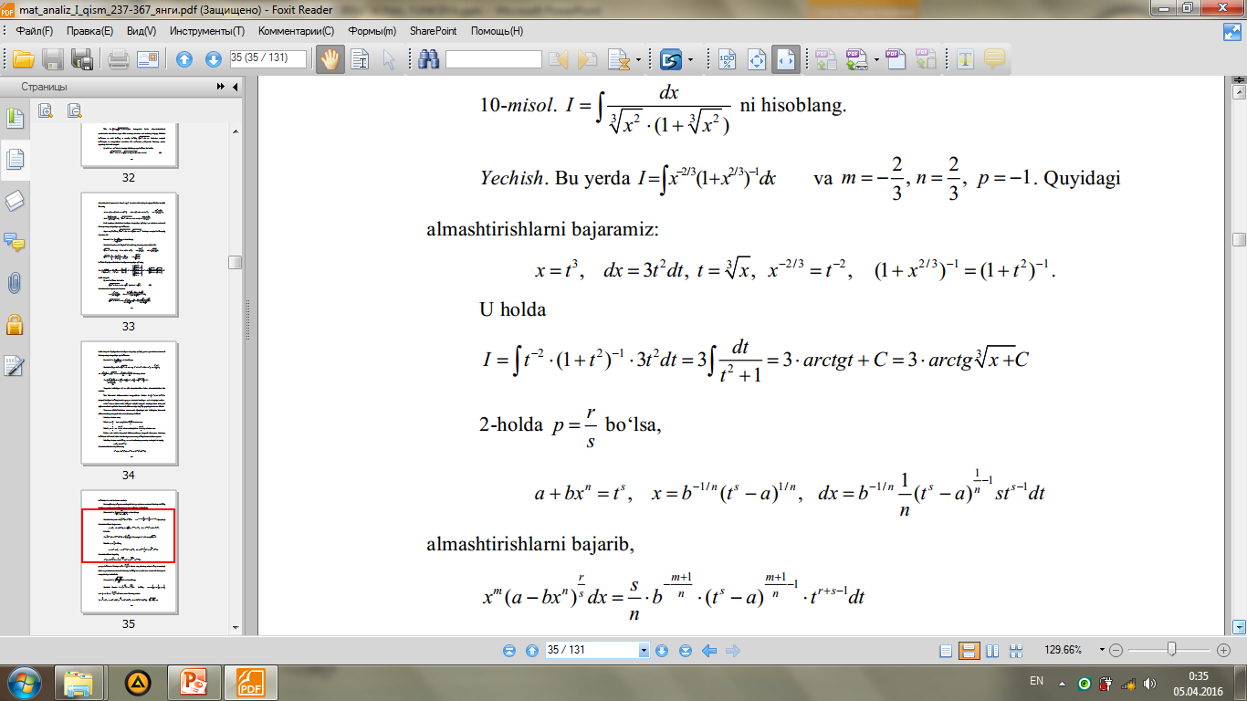

Slide 29
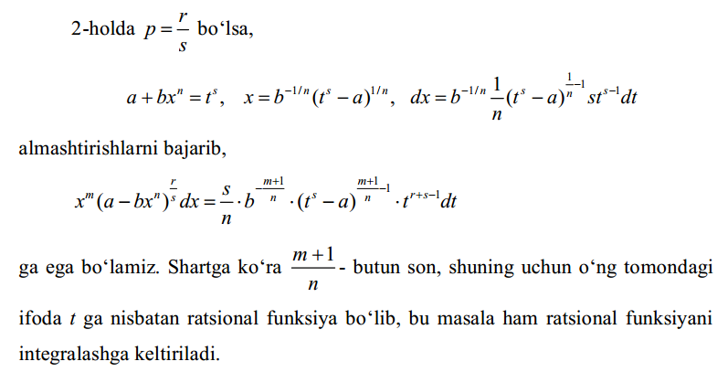

Slide 30
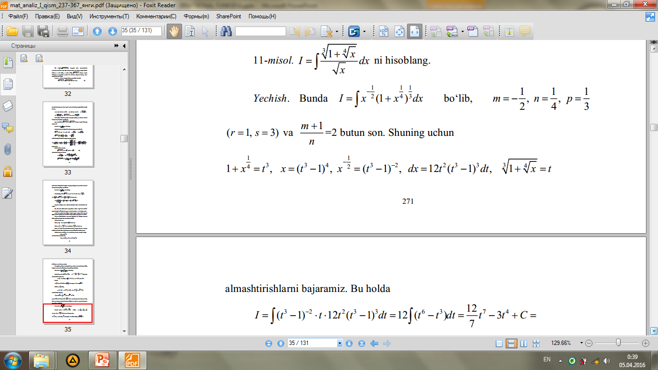
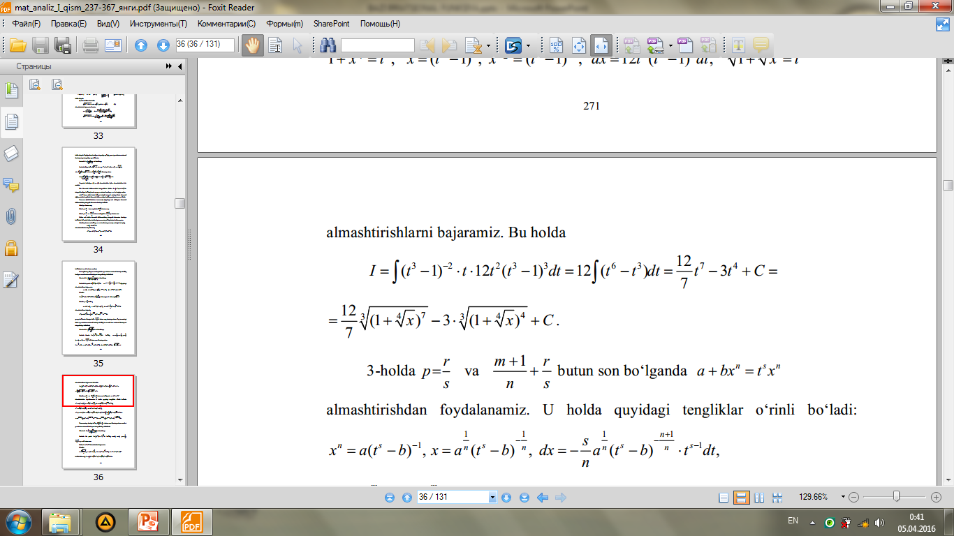

Slide 31
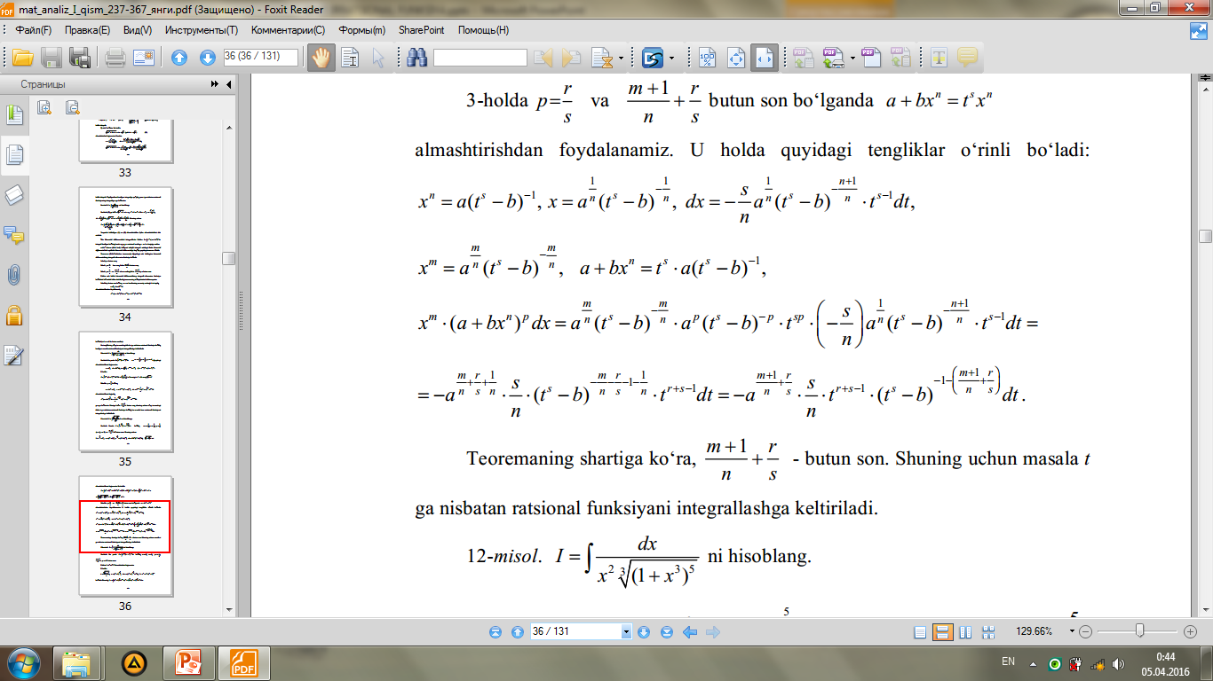

Slide 32
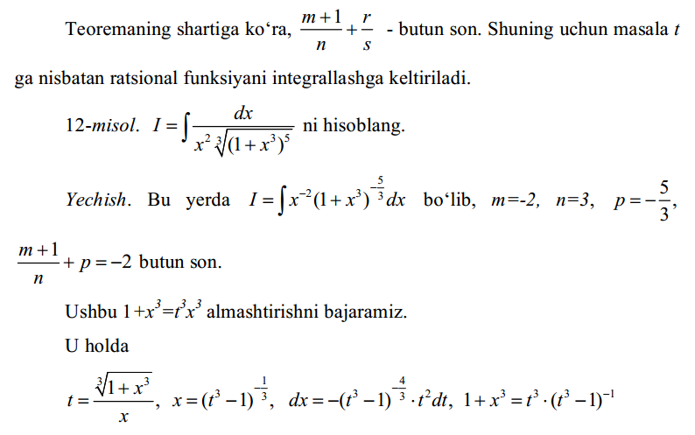

Slide 33
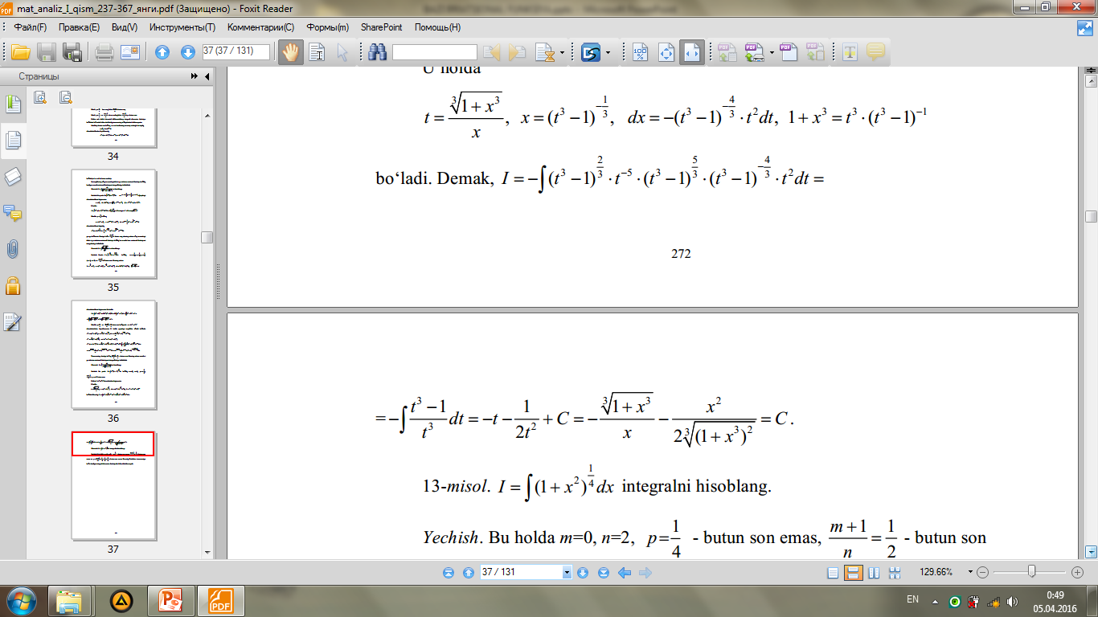
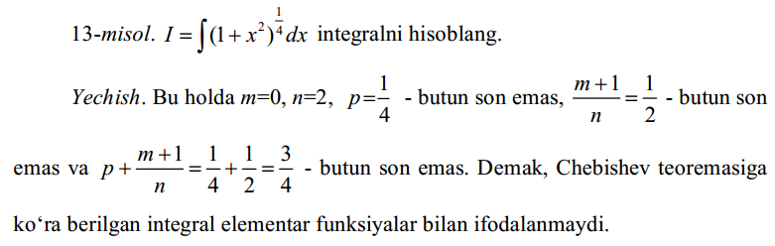

Slide 34
B/B/BX
BILAMAN
BILMAYMAN
BILISHNI XOHLAYMAN

Slide 35
Xulosa
Har qanday irratsional funksiyalarni ham integrallab bo`lavermaydi. Ba`zi irratsional funksiyalarnigina Eyler almashtirishlari , Binomial differensiallar orqali integrallash mumkin. Bu almashtirishlarni barchasi ratsional funksiyalarni integrallashga keltiriladi. Eyler almashtirishlarida ikkita hol qaraladi, boshqa hollarda bu funksiya mavjud bo`lmaydi, yoki to`g`ridan- to`g`ri ratsional funksiyaga keltirish mumkin.

Slide 36
Faollashtiruvchi savollar
Irratsional funksiya nima?
Irratsional funksiyaga misollar keltiring.
Yuqorida o`rganilgan irratsional funksiyalar sinfini ta`riflab bering.
Qanday almashritishlar yordamida ularni ratsional funksiyalar ko`rinishida yozish mumkin?
Qanday funksiyalar uchun Eyler almashtirishlari qo`llaniladi?
Eylerning qand ay almashtirishlarini bilasiz?
Binomial differensialini qanday ko`rinishlarini integrallash mumkin.

Slide 37
BA`ZI IRRATSIONAL FUNKSIYALARNI INTEGRALLASH
NIMA UCHUN?
…
“NIMA UCHUN” JADVALI

Slide 38

UYGA VAZIFA
$\int{\frac{2x+1}{\sqrt{x^{2}−4x+1}}dx;}$ 2) $\int{\frac{2x−3}{\sqrt{8−2x−x^{2}}}dx;}$ 3) $\int{\frac{7x−5}{\sqrt{{5+2x−x}^{2}}}dx;}$
4) $\int{\frac{dx}{\sqrt{{(2x+1)}^{3}−2x+1}};}$ 5) $\int{\frac{\sqrt{x}+3}{x(\sqrt{x}+\sqrt[3]{x})}dx.}$

Slide 39
Foydalanilgan adabiyotlar
1. Toshmetov O’., Turgunbayev R., Saydamatov E., Madirimov M. Matematik analiz I-qism. T.: “Extremum-Press”, 2015. -97-99 b.
2. Claudia Canuto, Anita Tabacco Mathematical analysis. I. Springer-Verlag. Italia, Milan. 2008.- 96-102p.
3. Xudayberganov G., Vorisov A., Mansurov X., Shoimqulov B. Matematik analizdan ma’ruzalar. I T.:«Voris-nashriyot». 2010 y. 85–91 b.

Slide 40
E`TIBORINGIZ UCHUN RAHMAT!

