Slide 1
Trigonometrik funksiyalarni integrallash. Universal usul

Slide 2
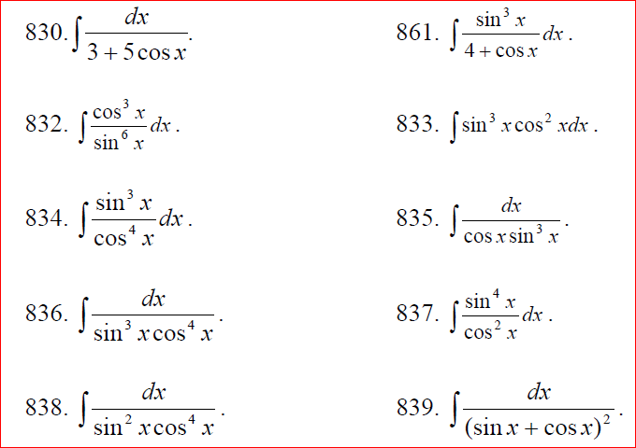

Slide 3
