Slide 1
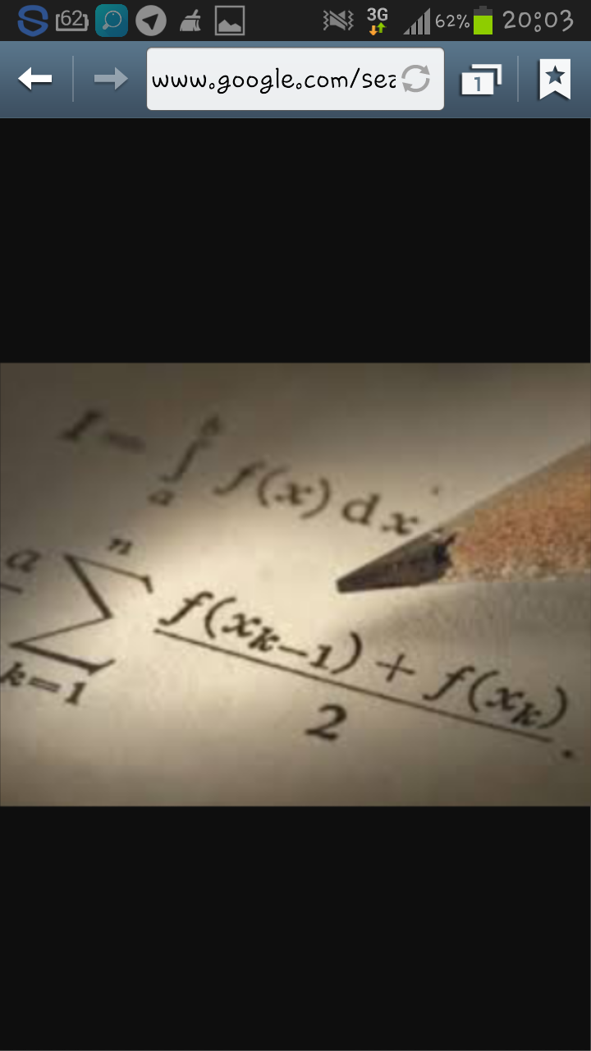
MAVZU: AYLANMA SIRT YUZASI TA`RIFI VA UNING ANIQ INTEGRAL YORDAMIDA IFODALANISHI
Bajardi: Ramazonova Laylo

Slide 2
Reja:
1. Aylanma sirt yuzasi ta’rifi.
2. Aylanma sirt yuzini aniq integral yordamida hisoblash

Slide 3

Aniq integralning xossalarini sanab bering.
Aniq integrallarning qanday tatbiqlarini bilasiz?
Aylanma jism haqida qanday ma`lumotlarni bilasiz?
Yuza tushunchasiga ta`rif bering.
Yuzani hisoblashning qanday formulalarini bilasiz?
Qutb koordinatalar sistemasida figuraning yuzasi qanday hisoblanadi?

Slide 4
ANIQ INTEGRALLARNING TATBIQLARI
YUZANI HISOBLASH FORMULALARI
QUTB KOORDINATALAR SISTEMASIDA FIGURANING YUZASINI HISOBLASH
FAZOVIY JISM HAJMINI HISOBLASH
EGRI CHIZIQ YOYI UZUNLIGINI HISOBLASH
AYLANMA SIRT YUZINI HISOBLASH
ANIQ INTEGRALNING FIZIK MASALALAR YECHISHGA TADBIQI

Slide 5

TAYANCH TUSHUNCHALAR
ANIQ INTEGRAL TUSHUNCHASI, YUZA TUSHUNCHASI, QUTB KOORDINATALAR SISTEMASI, AYLANMA SIRT HAQIDA TUSHUNCHA

Slide 6



B/BX/B JADVALI
BILAMAN
BILISHNI XOHLAYMAN
BILIB OLDIM

Slide 7
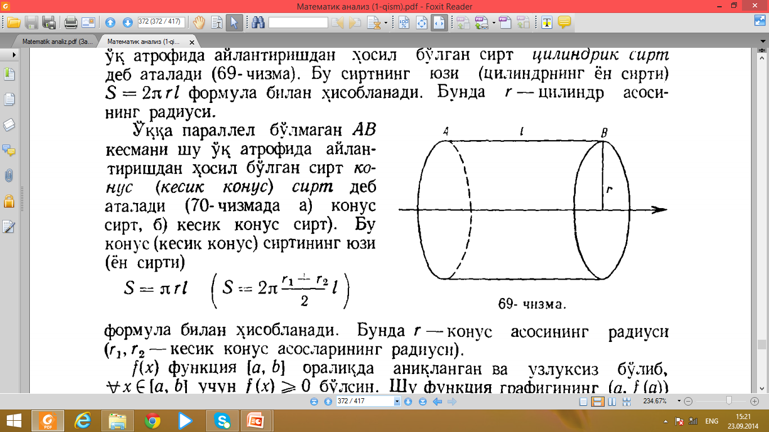
Ma`lumki, l uzunlikka ega bo`lgan AB kesmani unga parallel o`q atrofida aylantirishdan hosil bo`lgan sirt silindrik sirt deb ataladi. Bu sirtning yuzi ( silindrning yon sirti) S= 2πrl formula bilan hisoblanadi. Bunda r – silindr asosining radiusi.

Slide 8
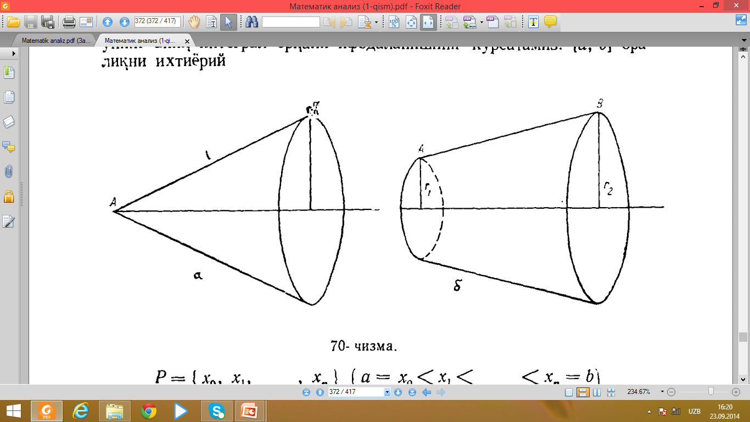

O`qqa parallel bo`lmagan AB kesmani shu o`q atrofida aylantirishdan hosil bo`lgan sirt konus (kesik konus) sirt deb ataladi. Bu konus (kesik konus) sirtining yuzi
S=$πrl S=2π\frac{r_{1 }+r_{2}}{2}$
formula bilan hisoblanadi. Bunda r- konus asosining radiusi

Slide 9
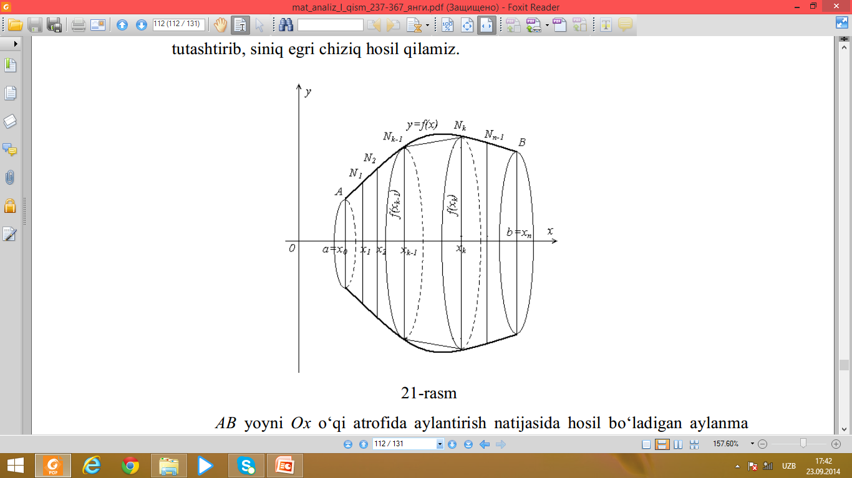
f(x) funksiya [ a,b] oraliqda aniqlangan va uzluksiz bo`lib, x∊[a,b] uchun f(x)≥0 bo`lsin. Shu funksiya grafigining (a ,f(a)) va (b,f(b)) nuqtalar orasidagi bo`lagini AB yoy deb yuritamiz. Shu AB yoyni Ox o`qi atrofida aylantirishdan hosil bo`lgan sirt aylanma sirt deb ataladi.

Slide 10
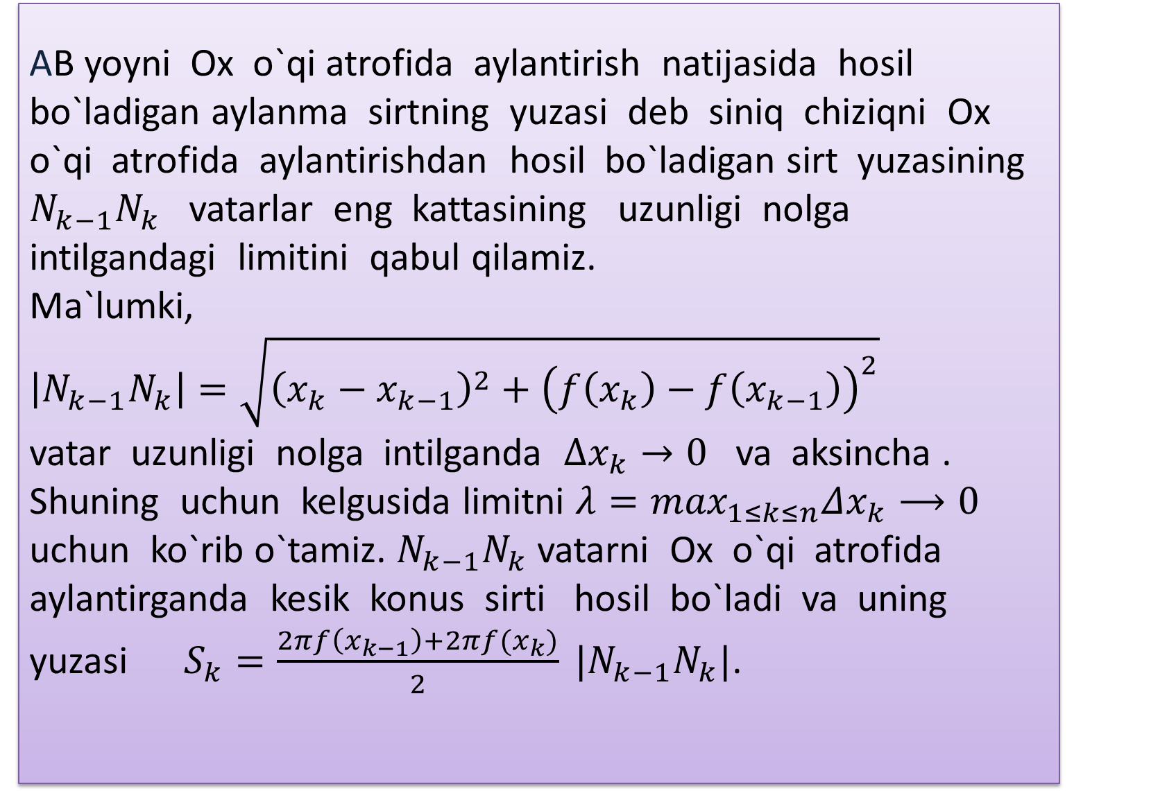
AB yoyni Ox o`qi atrofida aylantirish natijasida hosil bo`ladigan aylanma sirtning yuzasi deb siniq chiziqni Ox o`qi atrofida aylantirishdan hosil bo`ladigan sirt yuzasining $N_{k−1}N_{k}$ vatarlar eng kattasining uzunligi nolga intilgandagi limitini qabul qilamiz.
Ma`lumki, $\left|N_{k−1}N_{k}\right|=\sqrt{{\left(x_{k}−x_{k−1}\right)}^{2}+{\left(f\left(x_{k}\right)−f\left(x_{k−1}\right)\right)}^{2}}$ vatar uzunligi nolga intilganda $∆x_{k}→0$ va aksincha . Shuning uchun kelgusida limitni $λ=\max_{1≤k≤n}Δx_{k}⟶0$ uchun ko`rib o`tamiz. $N_{k−1}N_{k}$vatarni Ox o`qi atrofida aylantirganda kesik konus sirti hosil bo`ladi va uning yuzasi $S_{k}=\frac{2πf\left(x_{k−1}\right)+2πf(x_{k})}{2} |N_{k−1}N_{k}|$.

Slide 11

Shu tarzda hosil qilingan yuzalarning n tasini qo`shsak, siniq chiziq yordamida hosil qilingan sirt yuzasi $P_{n}$ kelib chiqadi: $P_{n}=2π\sum_{k=1}^{n}{\frac{f\left(x_{k−1}\right)+f(x_{k})}{2}}Δl_{k}, Δl_{k}=\left|N_{k−1}N_{k}\right|.$ Uni boshqacha ko`rinishda yozish mumkin:
$P_{n}=2π\sum_{k=1}^{n}{\frac{f\left(x_{k−1}\right)+f\left(x_{k}\right)}{2}Δs_{k}−2π\sum_{k=1}^{n}{\frac{f\left(x_{k−1}\right)+f\left(x_{k}\right)}{2}}({Δs}_{k}−Δl_{k})}$,
bunda $Δs_{k}$ mos ravishda $N_{k−1}$ va $N_{k}$ nuqtalar orasidagi yoy uzunligi.

Slide 12

Ma`lumki, $Δx_{k}→0$ da $∆s_{k}→0$ Shuningdek, $\frac{f\left(x_{k−1}\right)+f(x_{k})}{2}$ bo`linma $f(x_{k−1})$ va ${f(x}_{k})$ lar orasidagi son bo`lib, $f(x)$ funksiya uzluksiz bo`lganidan, shunday $ξ_{k}ε(x_{k−1},x_{k})$ mavjudki, $\frac{f\left(x_{k−1}\right)+f(x_{k})}{2}=f(ξ_{k})$ bo`ladi. $M=\max_{a≤x≤b}f\left(x\right)$ deb belgilaylik. $λ→0 da P_{n}$ning tarkibidagi ikkinchi qo`shiluvchi
$$0≤2π\sum_{k=1}^{n}{\frac{f\left(x_{k−1}\right)+f\left(x_{k}\right)}{2}}({Δs}_{k}−Δl_{k}=2π\sum_{k=1}^{n}{f\left(ξ_{k}\right)}({Δs}_{k}−Δl_{k})≤2πM\sum_{k=1}^{n}{{(Δs}_{k}−Δl_{k})=2πM\left(\sum_{k=1}^{n}{∆s_{k}−\sum_{k=1}^{n}{{∆l}_{k}}}\right)→0}$$

Slide 13

chunki
$$\lim_{λ→0}{\sum_{k=1}^{n}{∆l_{k}}=\sum_{k=1}^{n}{∆s_{k}}=L}$$
(yuqoridagi shartlarda AB yoyning to`g`rilanuvchanligi nazarda tutilgan).
$$\lim_{λ→0}{P_{n}=2π\lim_{λ→0}{\sum_{k=1}^{n}{f\left(ξ_{k}\right)∆s_{k}=2π\int_{a}^{b}{f\left(x\right)ds}}}}$$
bo`ladi, ya`ni aylanma sirtning yuzi
$$S=2π\int_{a}^{b}{f\left(x\right)ds=2π\int_{a}^{b}{f(x)\sqrt{1+{f′(x)}^{2}}}dx}$$
formula bilan ifodalanadi.

Slide 14

Agar to`g`rilanuvchi yoy tenglamasi
$\left\{\begin{aligned}x=φ\left(t\right), \\ y=ψ(t)\end{aligned}\right. (α≤t≤β)$ parametrik ko`rinishda berilgan bo`lib, $φ\left(t\right) va ψ(t)$ lar uzluksiz hosilalarga ega bo`lsa, u holda sirtning yuzasi
$$S=2π\int_{a}^{b}{ψ(t)\sqrt{{φ′(t)}^{2}+{ψ′(t)}^{2}}dt}$$
bo`ladi. Shunga o`xshash, agar egri chiziq $r=f\left(θ\right), α≤θ≤β$
tenglama bilan berilgan bo`lib, $f′(θ)$ uzluksiz funksiya bo`lsa,

Slide 15

$$S=2π\int_{a}^{b}{f\left(θ\right)sinθ\sqrt{f^{2}(θ)+{f′(θ)}^{2}}dθ}$$
formulani keltirib chiqaramiz.
Misol. Radiusi R bo`lgan sfera sirtining yuzasini toping.
Yechish. I usul. Aylana tenglamasi parametrik ko`rinishda quyidagicha yoziladi:
$$\left\{\begin{aligned}x=Rcost, \\ y=Rsint,\end{aligned} 0≤t≤2π\right.$$
chorak aylanani $Ox$ o`q atrofida aylantirish natijasida yarim sfera hosil bo`ladi.

Slide 16

Bu holda $0≤t≤\frac{π}{2}$ bo`ladi, shuning uchun
$$\frac{S}{2}=2π\int_{0}^{\frac{π}{2}}{Rsint\sqrt{{(−Rsint)}^{2}+{(Rcost)}^{2}}dt=}$$
$$=2πR^{2}\int_{0}^{\frac{π}{2}}{sintdt=−2πR^{2}cost\left|\begin{aligned}\frac{π}{2} \\ 0\end{aligned}\right.=2πR^{2}.}$$
Demak, $S=4πR^{2}$.

Slide 17


II usul. Qutb koordinatalar sistemasida aylana tenglamasi $r=R, 0≤θ≤2π.$ Shuning uchun
$\frac{S}{2}=2π\int_{0}^{\frac{π}{2}}{Rsinθ\sqrt{R^{2}+0}dθ=2πR^{2}\int_{0}^{\frac{π}{2}}{sinθdθ=2πR^{2}}}$,
$$S=4πR^{2}.$$

Slide 18
Aniq integralni hisoblash nima uchun kerak?
Aylanma sirt yuzasini hisoblash uchun.
Aylanma sirt yuzasini hisoblash nima uchun kerak?
............

Slide 19
Parametrik ko`rinishdagi tenglama bilan berilgan sirt yuzasi qanday hisoblanadi?
Qutb koordinatalar sistemasida berilgan aylanma sirt yuzasi qaysi formula orqali hisoblanadi?
Aylanma sirt qanday hosil bo`ladi?
Aylanma sirt yuzasini hisoblashning yana qanday usullarini bilasiz?
SAVOL VA TOPSHIRIQLAR

Slide 20

1. $y=sinx, y=0, 0≤x≤π$ chiziqlar bilan chegaralangan figura yuzini hisoblang.
$π$ B) 2 C) 2$π$ D) 1
$y=\frac{x^{2}}{2}, y=1/(1+x^{2})$ chiziqlar bilan chegaralangan figura yuzini hisoblang.
$\frac{π}{2}$ B) $\frac{π}{2} −\frac{1}{3}$ C) $\frac{1}{3}−\frac{π}{2}$ D)$π−2$
3. $y=sinx, y=cosx$egri chiziqlar va $Ox$ o`qi bilan chegaralangan figura yuzini hisoblang.
A) $\frac{3π}{2}$ B) $2π−\sqrt{2}π$ C) 2-$\sqrt{2}$ D)2+$\sqrt{2}$
Tekshirish uchun test savollari

Slide 21
(AYLANMA SIRT YUZASI NI HISOBLASHGA ASOSAN )
“V” – men bilgan ma`lumotlarga mos;
“-” - men bilgan ma`lumotlarga zid;
“+” – men uchun yangi ma`lumot;
“?” – men uchun tushunarsiz yoki ma`lumotni aniqlash, to`ldirish talab etiladi
INSERT JADVALINI TO`LDIRING
V + - ?

Slide 22
FOYDALANILGAN ADABIYOTLAR
1. Azlarov T., Mansurov X., Matematik analiz 1-qism
T.: “O`qituvchi”, 1994- 416 b
Xudoyberganov G. va boshq. Matematik analizdan ma`ruzalar. I qism 2010
O`. Toshmetov , R.M.Turg`unbayev, E.M.Saydamatov, M. Madirimov. Matematik analiz I qism T.: “Extremum- Press” 2015

Slide 23
E`TIBORINGIZ UCHUN RAHMAT!

