Slide 1
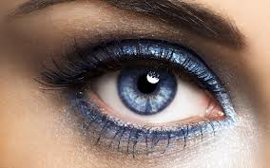
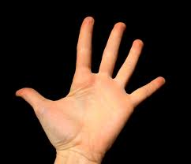
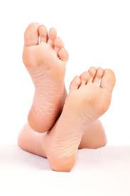
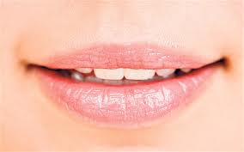
Idioms with parts of the body

Slide 2
idiom
Definition of idiom:
An expression that cannot be understood from the meanings of its separate words.
A term or a phrase whose meaning cannot be deduced from the literal definitions or arrangement of its parts.
A figurative meaning that is known only through common use
Example: “The test was a piece of cake!!”

Slide 3

To be a big mouth
Examples:
She’s such a big mouth. She’s always gossiping…

Slide 4
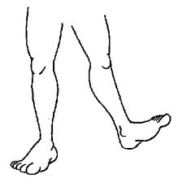
To be ON LAST LEGS
Example:
My grandpa is on his last legs. He’s not the same as he used to be…

Slide 5
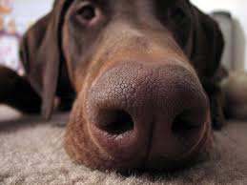
To be UNDER YOUR NOSE
Example:
He’s such a distracted person. He was looking for his glasses and they were under his nose all along!

Slide 6

To GET IT OFF YOUR CHEST
Example:
I have to get this off my chest. I love you!

Slide 7
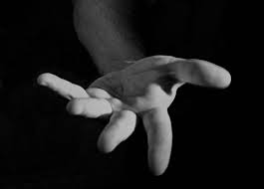
To give a hand
Example:
Everyone needs to give a hand to those who need help.

Slide 8

To HAVE A SHOULDER TO CRY ON
Example:
It’s always good to have a best friend because he/she can be your shoulder to cry on.

Slide 9
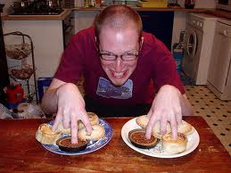
To have your fingers in a lot of pies
Example:
He’s always so stressed because he has his fingers in a lot of pies.

Slide 10
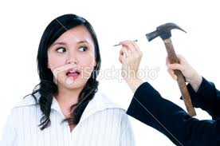
To hit the nail on the head
Example:
You´re so smart. You always hit the nail on the head.

Slide 11

To learn something by heart
Example:
Law is a difficult major. You have to learn many things by heart.

Slide 12
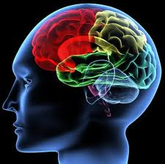
To make up your mind
Example:
Please make up your mind. Do you want vanilla or chocolate ice cream?

Slide 13

To play it by ear
Example:
I decided not to practice for the audition and just play it by ear.

Slide 14
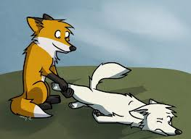
To pull someone’s leg
Example:
I don’t believe that happened. You’re pulling my leg!

Slide 15
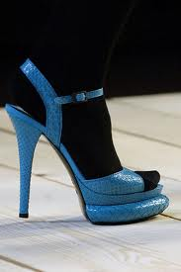
To put your foot down
Example:
I like Jane because she always wants to be fair and she puts her foot down if it’s necessary.

Slide 16
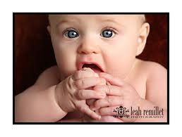
To put your foot in your mouth
Example:
I feel so embarrassed. I can’t believe I put my foot in my mouth again!

Slide 17
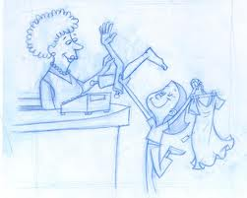
To cost an arm and a leg
Did you see her ring? Her boyfriend payed an arm and a leg for it!

Slide 18
Now match the following definitions with one of the idioms you just saw…

Slide 19
1. To be very old…
2. to say something unintentionally that makes someone feel bad…
3. a person who talks too much and cannot keep secrets…
4.to keep your point firmly…
5. to refer to something that is very obvious.
6. to fool/trick/kid someone. To play a joke on someone.
7. to improvise something.
8.something that is really expensive.
9.to talk about a difficult situation
10. to make a decision
11.to help someone with something. To applaud.
12. to memorize something.
13. to have someone hear you wehn you need it.
14. to be right about something.
15. to be involved in several activities

Slide 20
Now…
Decide which of the idioms is more appropriate
Please______________ . Do you want to be my girlfriend or not?
Put your foot in your mouth
Make up your mind
Give me a hand

Slide 21
If you want to learn a language. It is necessary that you _________ the verbs ____________.
Have …in a lot of pies
Get ….off your chest
Learn…by heart

Slide 22
I really want to buy that car, but it costs ___________________.
An arm and a leg
A nail in the head
Shoulder to cry on

Slide 23
My friends told me that there was no school today. Unfortunately, they were just ______________.
a. under my nose
b. giving a hand
c. pulling my leg

Slide 24
Cindy is a great friend. She’s always willing to _______________________.
A. be under your nose
B. play it by ear
C. give a hand

Slide 25

Now write a small conversation with a partner using 4 of the idioms….

Slide 26
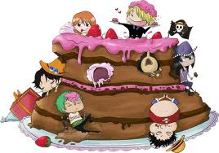
See!!
Learning idioms is a piece of cake…

